Slide 1
Climate Forcing and Models
Joy Campbell

Slide 2
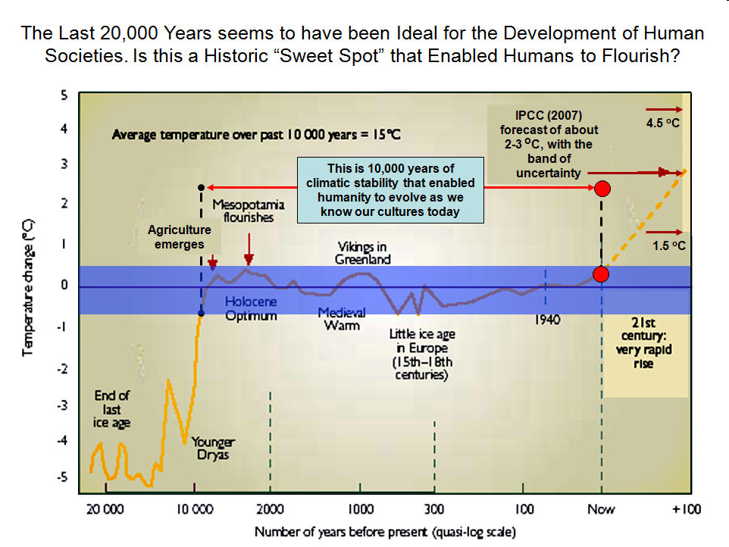

Slide 3
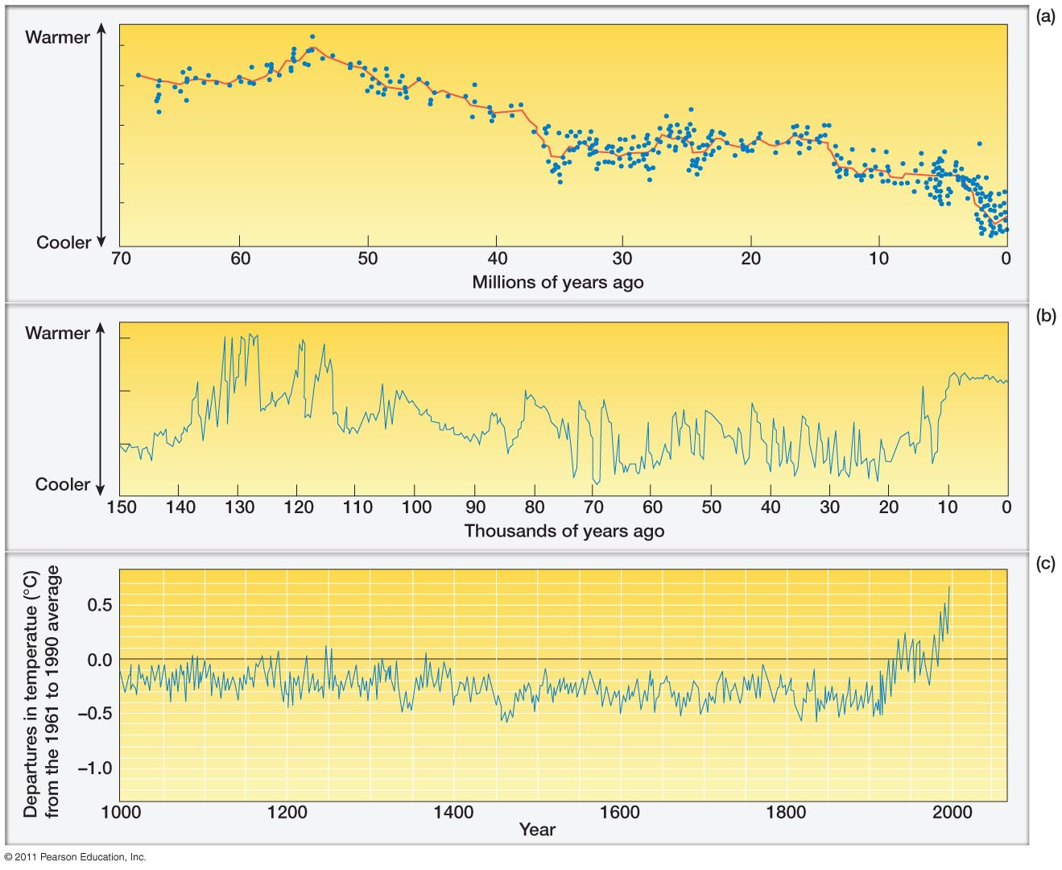
Historical Climate record

Slide 4
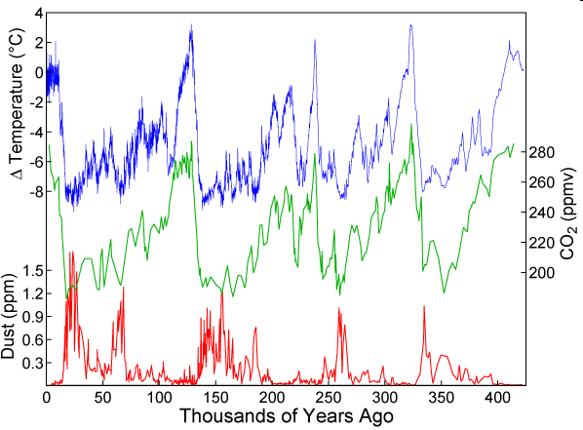
Notes:
Temp, CO2, Dust in atmosphere: Last 450 thousand years.

Slide 5
What have we learned because of paleoclimate records?

Slide 6
Global Climate Forcing
Climate forcing: mechanisms that affect climate
Atmospheric Aerosols
Fluctuations in Solar Output
Greenhouse Gas Concentrations
Milankovitch Cycles

Slide 7
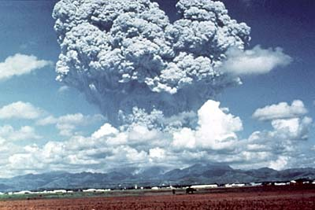
Aerosols: Volcanic Eruptions
Mount Pinatubo, Philippines
June 15, 1991
Caused Global Temp. to drop about 1˚F for 2 years.

Slide 8
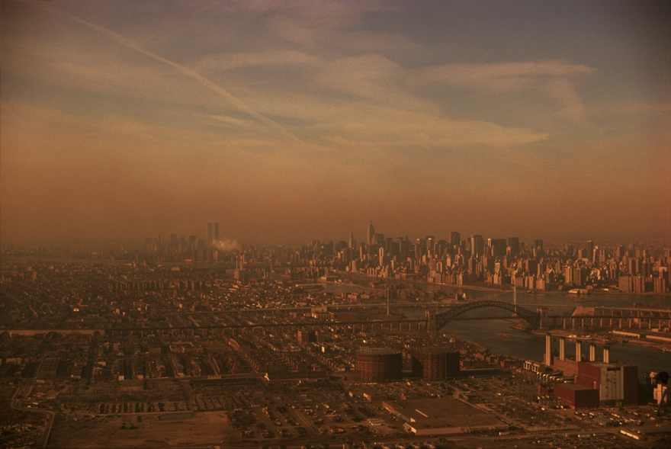
Aerosols: Air Pollution
Sulfur Dioxide
  Most likely caused cooling from ~1940s-1970s
  Yay Clean Air Act!
Particulate matter
  May cause cooling, may cause warming.
Notes:
http://www.ecoficial.com/epa-proposes-stronger-air-quality-standards-for-sulfur-dioxide-589/

Slide 9
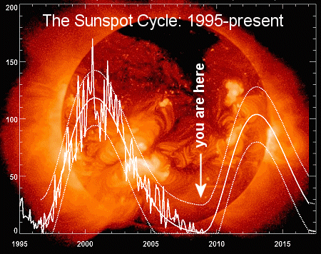
Solar Forcing
Sunspots
  Fewer sun spots during The Little Ice Age (~ 1400-1850 AD)
  ~ 11 year cycle, variations of ~ .1%
Notes:
http://www.iceagenow.com/Sunspots_and_global_cooling.htm

Slide 10
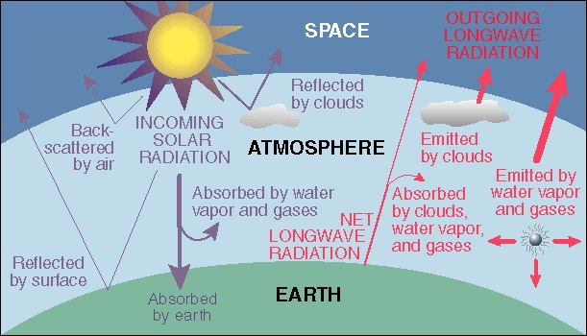
Greenhouse Gas Concentrations
Greenhouse gas concentrations are related to temperature, determined in part from Ice core records.
Evidence of CO₂ increase being anthropogenic
Notes:
http://zebu.uoregon.edu/1998/es202/l13.html

Slide 11
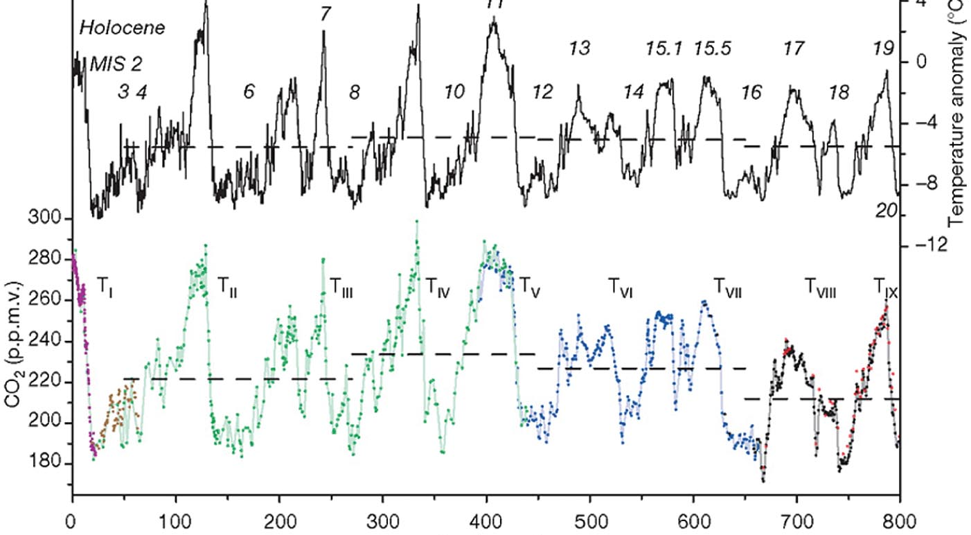
Greenhouse Gas Concentrations: Dome C
Notes:
Ice core records helped scientists determine Milankovitch cycles as well as other climate forcing mechanisms

Slide 12
Milankovitch Cycles
Eccentricity: “shape” of Earth’s orbit: how circular it is: 100,000 years.
Obliquity: the inclination of the Earth’s axis (tilt) ranges from 22.1° to 24.5°: 41,000 years.
Precession: the wobble of the Earth as it spins. Like a top. 25,800 years

Slide 13
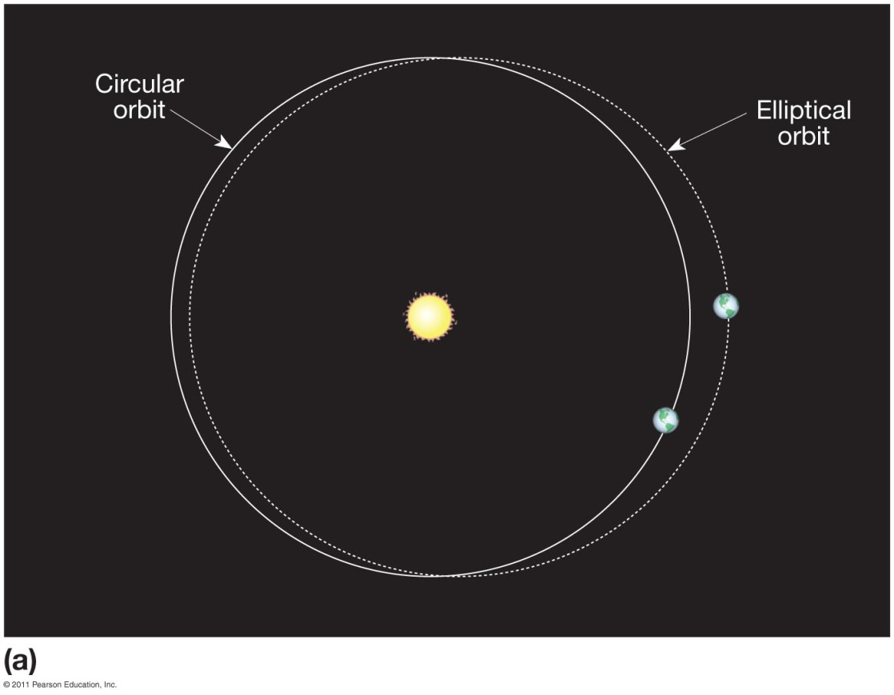
Eccentricity
Changes the distance of aphelion and perihelion by about 5,000,000 km
Glaciation in the N. Hem. Is promoted when there is LESS sunlight and COOLER summers.
  Eccentricity is at it’s highest: less circular IF N. Hem summer is at Aphelion (further)

Slide 14
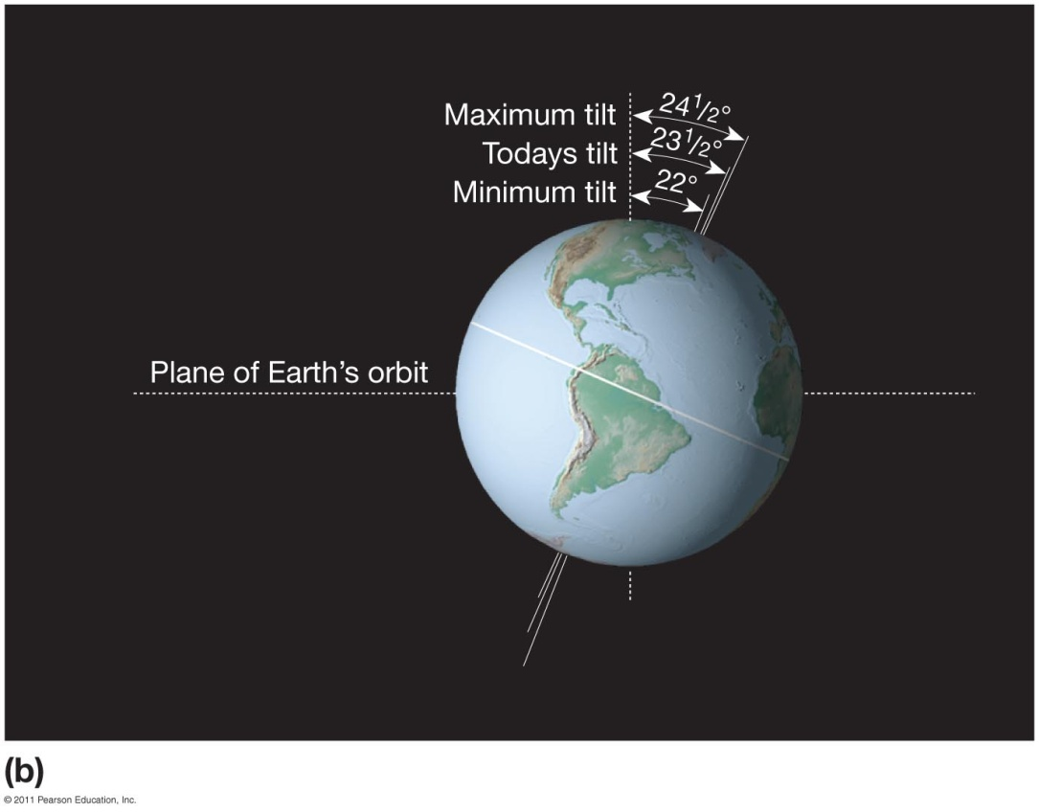
Obliquity
Tilt of the Earth
Glaciation in the N. Hem. Is promoted when there is LOW SEASONAL CONTRAST
  Less Tilt

Slide 15
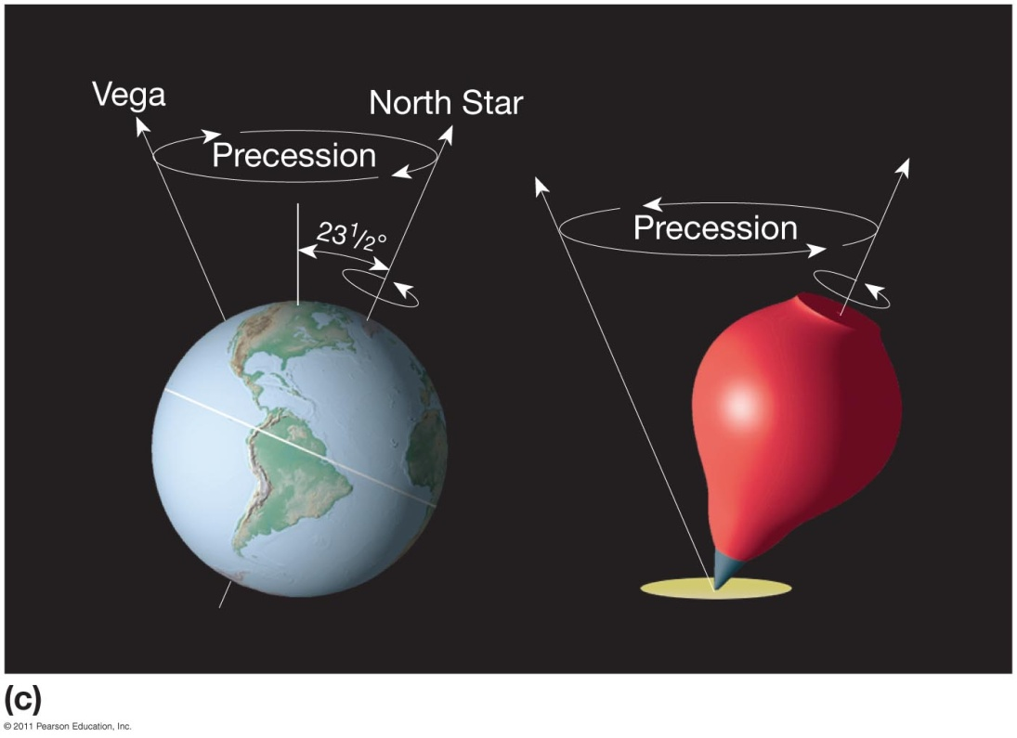
Precession
Direction of the tilt of the Earth: The wobble
Glaciation in the N. Hem. Is promoted when there is LOW SEASONAL CONTRAST
  In the N. Hem.’s summer the tilt is furthest from the sun.

Slide 16
Climate Models
  General circulation models (GCMs)
    Mathematical model of Earth’s climate system
    To understand what controls climate
  Numerous assumptions
    To make it simpler
    Amount of solar radiation at the surface of the Earth
    Ocean temperatures
    Greenhouse gas concentrations
    Albedo
    more
  Accuracy of the models
    Has to pass tests to predict current climate AND past climate.

Slide 17
Emission Scenarios
Global
A1B
A1
B1
A1FI
Governance
A1T
Economic
Development
Environmental
A2
B2
Adapted from Arnell et al. (2004). Global Environmental Change, 14:3-20
Local
Notes:
B2 is communist scenarios

Slide 18

Gross Domestic Product Growth at 2100
Global
A1
B1
Governance
Economic
Development
Environmental
A2
B2
Adapted from Arnell et al. (2004). Global Environmental Change, 14:3-20
Local
Notes:
IPCC AR4 WG1 SPM:
A1: Describes a future world of very rapid economic growth. Major underlying themes are convergence among regions, capacity building and increased cultural and social interactions, with a substantial reduction in regional differences in per capita income.
A2: The A2 storyline and scenario family describes a very heterogeneous world. The underlying theme is self reliance and preservation of local identities. Economic development is primarily regionally oriented and per capita economic growth and technological change more fragmented and slower than other storylines.
B1: Rapid change in economic structures toward a service and information economy. The emphasis is on global solutions to economic, social and environmental sustainability, including improved equity, but without additional climate initiatives.
B2: The B2 storyline and scenario family describes a world in which the emphasis is on local solutions to economic, social and environmental sustainability. Intermediate levels of economic development. While the scenario is also oriented towards environmental protection and social equity, it focuses on local and regional levels.

Slide 19




Energy Use at 2100
Global
A1
B1
Governance
Economic
Development
Environmental
A2
B2
Adapted from Arnell et al. (2004). Global Environmental Change, 14:3-20
Local
Notes:
IPCC AR4 WG1 SPM:
A1: A future world of very rapid economic growth.
A2: The A2 storyline and scenario family describes a very heterogeneous world. The underlying theme is self reliance and preservation of local identities. Economic development is primarily regionally oriented and per capita economic growth and technological change more fragmented and slower than other storylines.
B1: Rapid change in economic structures toward a service and information economy, with reductions in material intensity and the introduction of clean and resource
efficient technologies.
B2: Less rapid and more diverse technological change than in the B1 and A1 storylines.

Slide 20
Technological Change at 2100
A1FI
Global
A1B
B1
Governance
A1T
Economic
Development
Environmental
A2
B2
Adapted from Arnell et al. (2004). Global Environmental Change, 14:3-20
Local
Country B
Notes:
IPCC AR4 WG1 SPM:
A1: The A1 scenario family develops into three groups that describe alternative directions of technological change in the energy system. The three A1 groups are distinguished by their technological emphasis: fossil intensive (A1FI), non-fossil energy sources (A1T), or a balance across all sources (A1B) (where balanced is defined as not relying too heavily on one particular energy source, on the assumption that similar improvement rates apply to all energy supply and end use technologies).
A2: The A2 storyline and scenario family describes a very heterogeneous world. The underlying theme is self reliance and preservation of local identities. Economic development is primarily regionally oriented and per capita economic growth and technological change more fragmented and slower than other storylines.
B1: Rapid change in economic structures toward a service and information economy, with reductions in material intensity and the introduction of clean and resource
efficient technologies.
B2: Less rapid and more diverse technological change than in the B1 and A1 storylines.

Slide 21
Scenarios
A2 storyline: “Business as Usual”
  Heterogeneous world –no technology sharing
  Population continues to increase
A1 storyline: “Middle of the Road”
  World of rapid economic growth
  Population peaks 2050
  Different branches dependent on energy type/use
    A1FI – Fossil intensive –dependence on coal/oil
    A1B – Balance between fossil and non-fossil
B1 storyline: “Optimistic Pathway”
  Global exchange/cooperation
  Focus on social, economic and environmental sustainability

Slide 22
What factors affect future CO₂ levels?
Global Population (Demographics)
Type of energy generation
  Fossil intensive
  Renewable energy
Growth of Economy
Type of Economy
  Material based
  Service and information based
Cooperation among countries (Globalization)
  More homogeneous - share technologies
  More isolated - larger divide between rich/poor countries

Slide 23
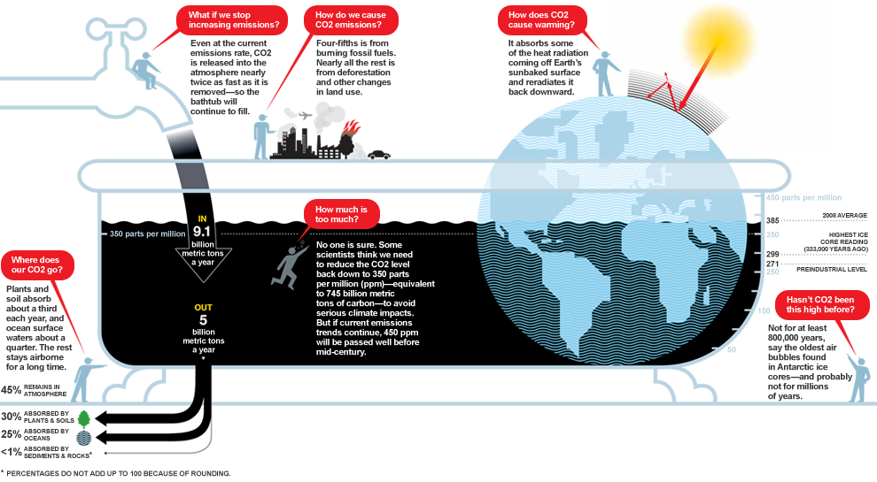
Carbon Bathtub Concept

Slide 24
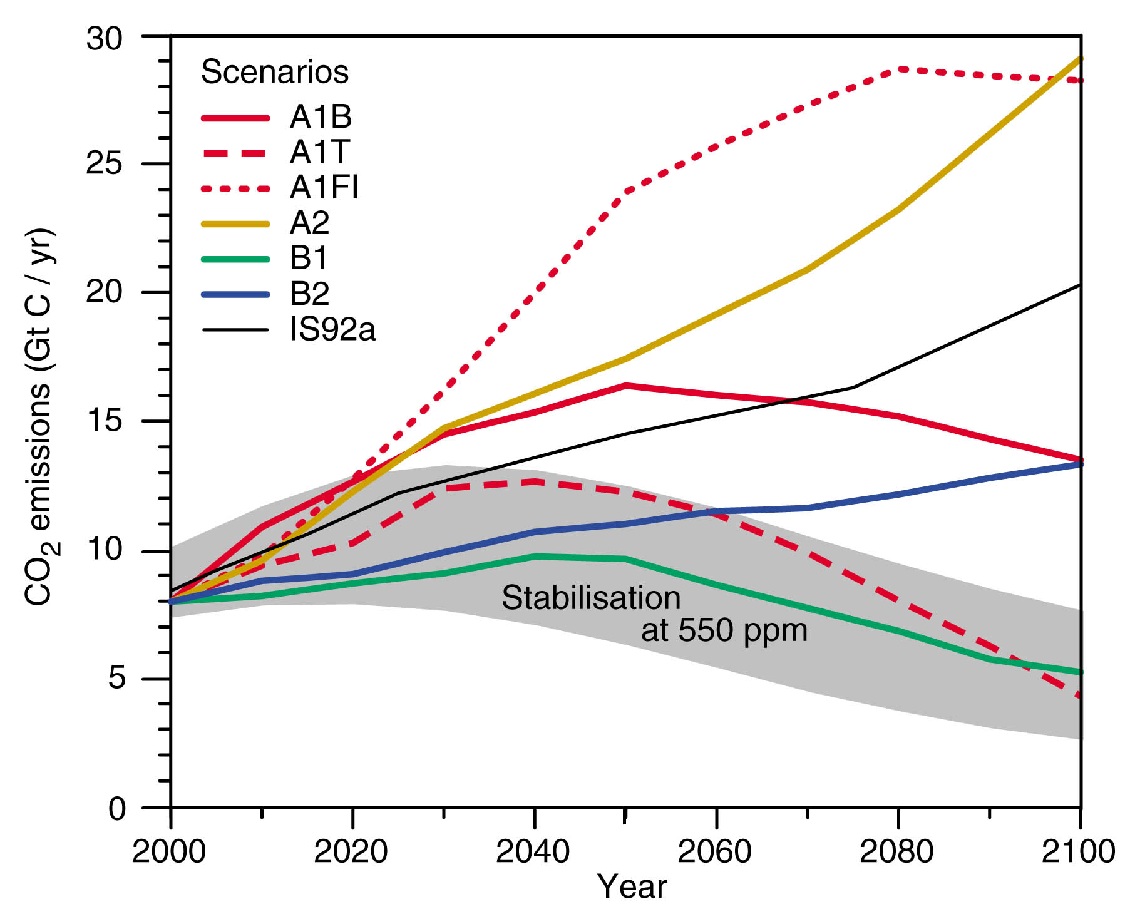
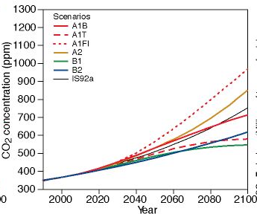
CO₂ emissions for various scenarios
Even optimistic scenarios result in greatly increased CO₂ concentrations by the year 2100
  Max: 820 ppm: SRES-A2 “Business as Usual” 3x CO2
  Min: 550 ppm: SRES-B1 “Optimistic Pathway” 2x CO2

Slide 25
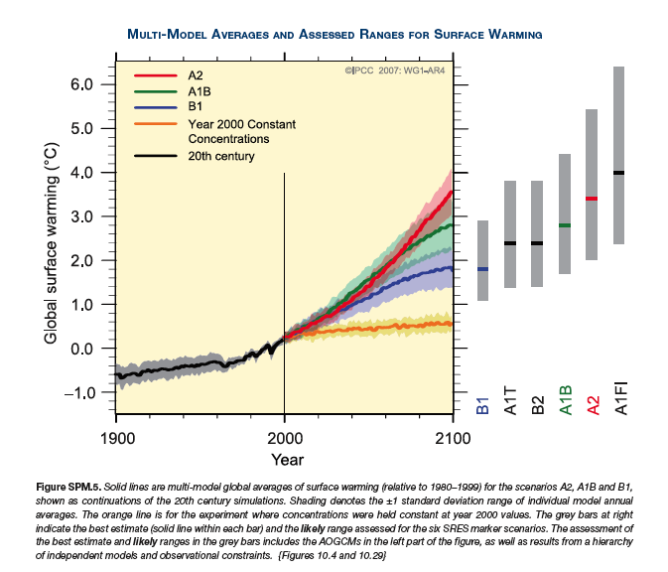
Future Climate Simulations
Some warming is “committed”
Emissions
Uncertainty

Slide 26
Global Mean Temperature Projections
Each bar on the right represents a range of warming produced by models of differing sensitivies for a specific scenario.
For the next two decades, a warming of about 0.2°C per decade is projected. This is about the same rate as observed since 1990.
Projected Warming: 2000 – 2100 ranges from 2.0 to 4.5 degrees Celsius
By the end of the 21st century, emission pathways matter!
  SRES-B1: +1.8C (1.1-2.9C)
  SRES-A1B: +2.8C (1.7-4.4C)
  SRES-A2: +4.0C (2.4-6.4C)

Slide 27
Global Climate Models (GCMs) defined: numerical representations of the climate system, including atmosphere, ocean, sea ice and vegetation
A really extended weather forecast
Like weather forecast models, they solve fundamental mathematical equations
Equations are very complicated
Some of the world’s largest supercomputers are running climate models.

Slide 28
Modeling: A 5 Dimensional Problem
Time
Space (3-D)
Probability
Climate models can’t tell you what the weather will be like on April 16, 2059
But they can tell you a range of what climatological statistics of a April 16, 2059 day would look like
  1-3 C warmer than April 16 in present climate

Slide 29
Conduct experiments on “Earth”
Can not conduct “experiments” on Earth…
  …but perhaps we can simulate it
“…human beings are now carrying out a large scale geophysical experiment of a kind that could not have happened in the past nor be reproduced in the future”
-Revelle and Seuss 1957

Slide 30
Caveats to Global Climate Models
Coarse scale grids
Inability to fully resolve topographic features
Inability to fully simulate clouds and precipitation processes

Slide 31
Why should we trust these models to predict the future?
Validity of model projections depends on:
Simulate present day climate
Simulate past changes in climate

Slide 32
Applications and typical results of GCMs:
Rain (cm/yr)
Data
Model

Slide 33
Can Models Simulate Anthropogenic Forcing?
How well can models represent changes in climate system induced by the addition of greenhouse gases and aerosols?

Slide 34
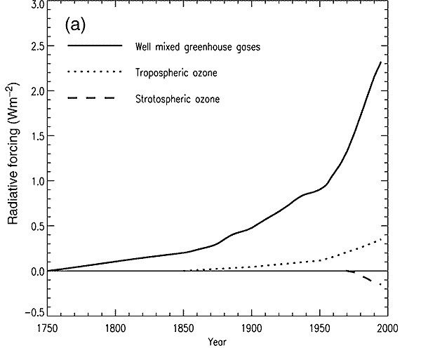
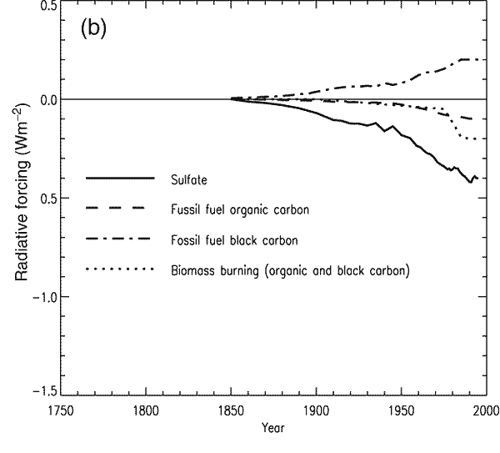
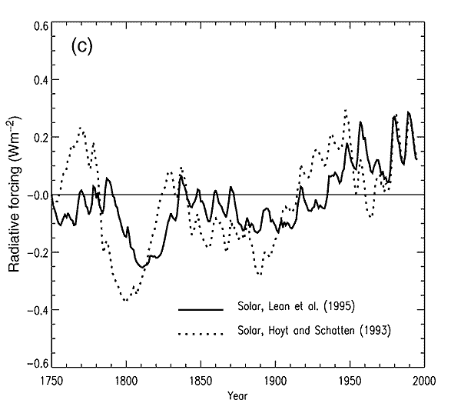
Consider the “known” 20th Century Perturbations
Greenhouse Gases
Aerosols
Note Scale
Difference
Solar

Slide 35
Model Schematic
Perturbation (e.g., changes in CO2)
Climate Model
Climate response (e.g., change in temperature)

Slide 36
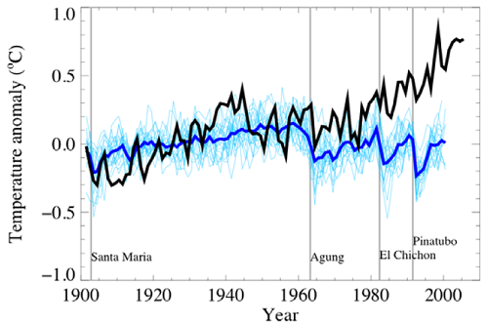
20th Century Climate: Model Simulations
Observations
Solar + volcanic
Experiment 1: Only apply natural forcing: solar + volcanic
  Apply known forcings to variety of GCMs, ‘Ensemble’ runs with different initial conditions (thin lines)

Slide 37
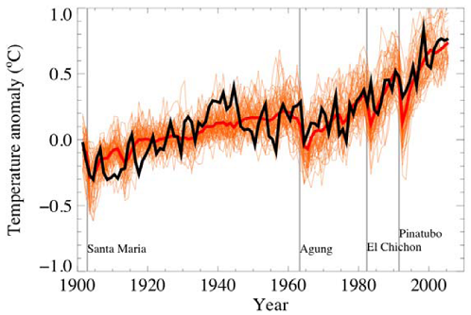
20th Century Climate: Model Simulations
Observations
All Forcing
Experiment 2: Now apply anthropogenic forcing + natural
  Without anthropogenic forcing it is very difficult to explain global surface temperature record over the past 100 years

Slide 38
Predicting Future Climate
Solar irradiance and volcanic aerosols
  Have not played dominant role in long term climate changes in past 150 years
  Hence these are ignored in climate change runs
Greenhouse gas and aerosol emissions
  Future socioeconomic and energy policies provide us with idea of future emissions
  Since changes have been attributed to increases in atmospheric concentrations, then future climate change hinges on predicting their concentrations

Slide 39
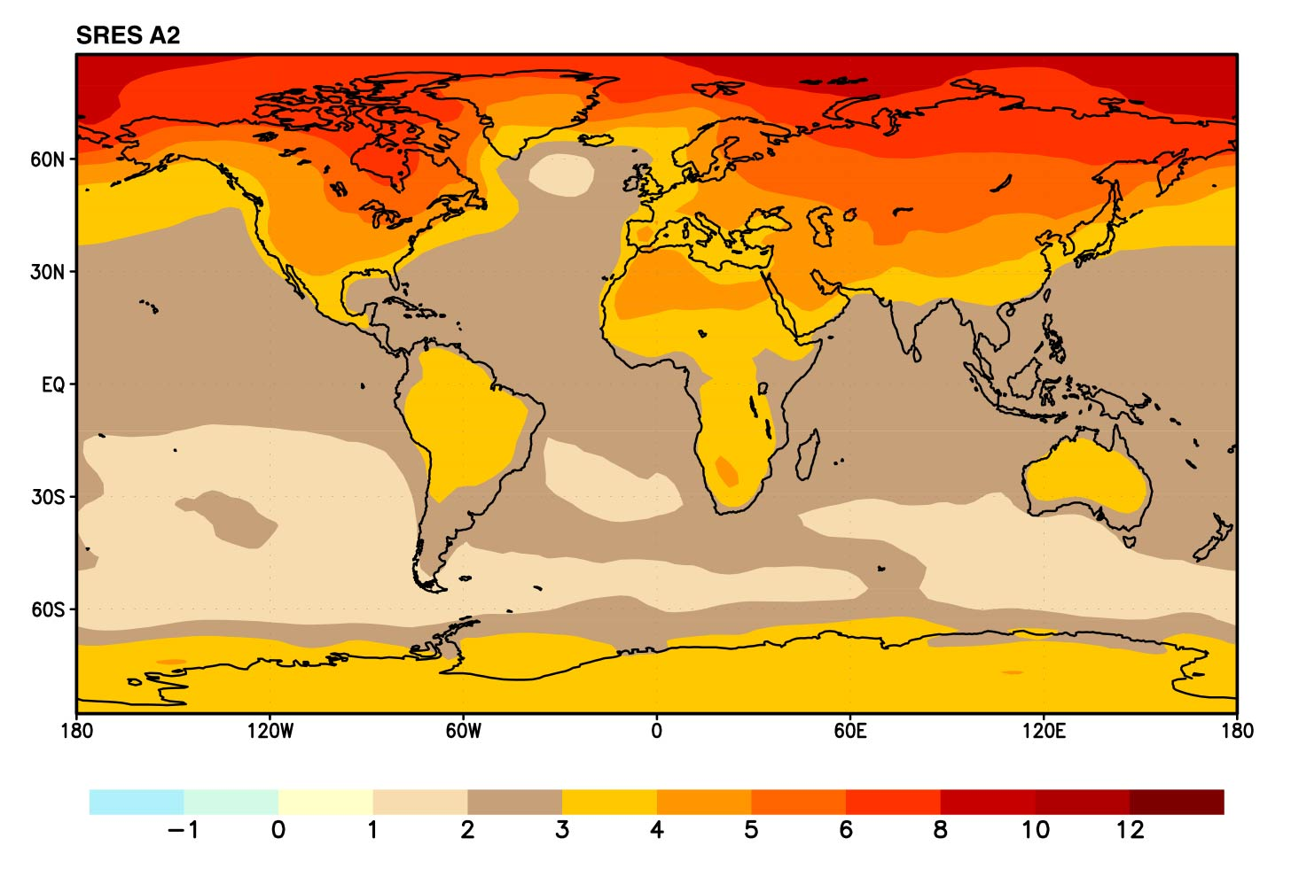
Land areas are projected to warm more than the oceans with the greatest warming at high latitudes
Annual mean temperature change, 2071 to 2100 relative to 1990: Global Average in 2085 = 3.1ºC

Slide 40
Spatial differences in temperature projections
Regionally, largest temperature increases
  Over land areas
    Warming largest in locations tending toward aridity
  At high latitudes
    Amplified due to snow-albedo feedback
Hollywood Science
  some models indicate cooling over N. Atlantic (Day After Tomorrow…)

Slide 41
Precipitation
Observations
General increases over past century ~ %1
Regionally largest at high latitudes (5-20%)
Decreases in Subtropical areas
Physical mechanisms
warmer temperatures increase evaporation: more vigorous hydrologic cycle
Warmer atmosphere holds more water vapor: more intense precipitation

Slide 42
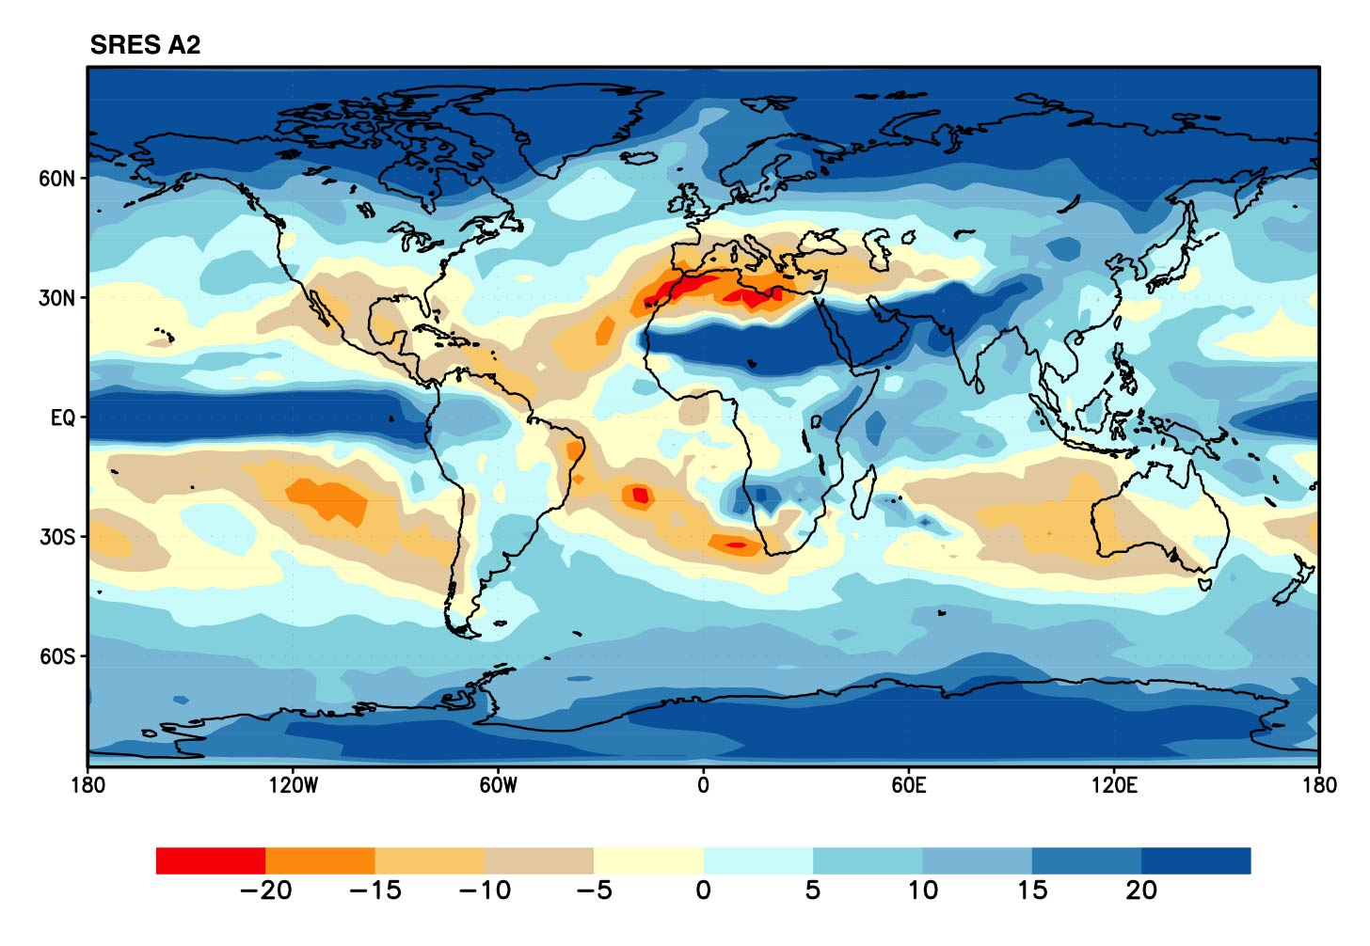
Some areas are projected to become wetter, others drier with an overall increase projected
Annual mean precipitation change: 2071 to 2100 Relative to 1990
Notes:
42

Slide 43
Future Precipitation Predictions
Increased precipitation is very likely in high latitudes due to a warmer atmosphere and poleward movement of storm track
Decreased precipitation is likely in subtropical areas due to the lack of winter rains
Areas which see precipitation currently falling at temperatures between -3C to 0C will likely see a dramatic decrease in the fraction of precipitation falling as snow
In general, confidence in regional changes in precipitation less than those for temperature changes

Slide 44
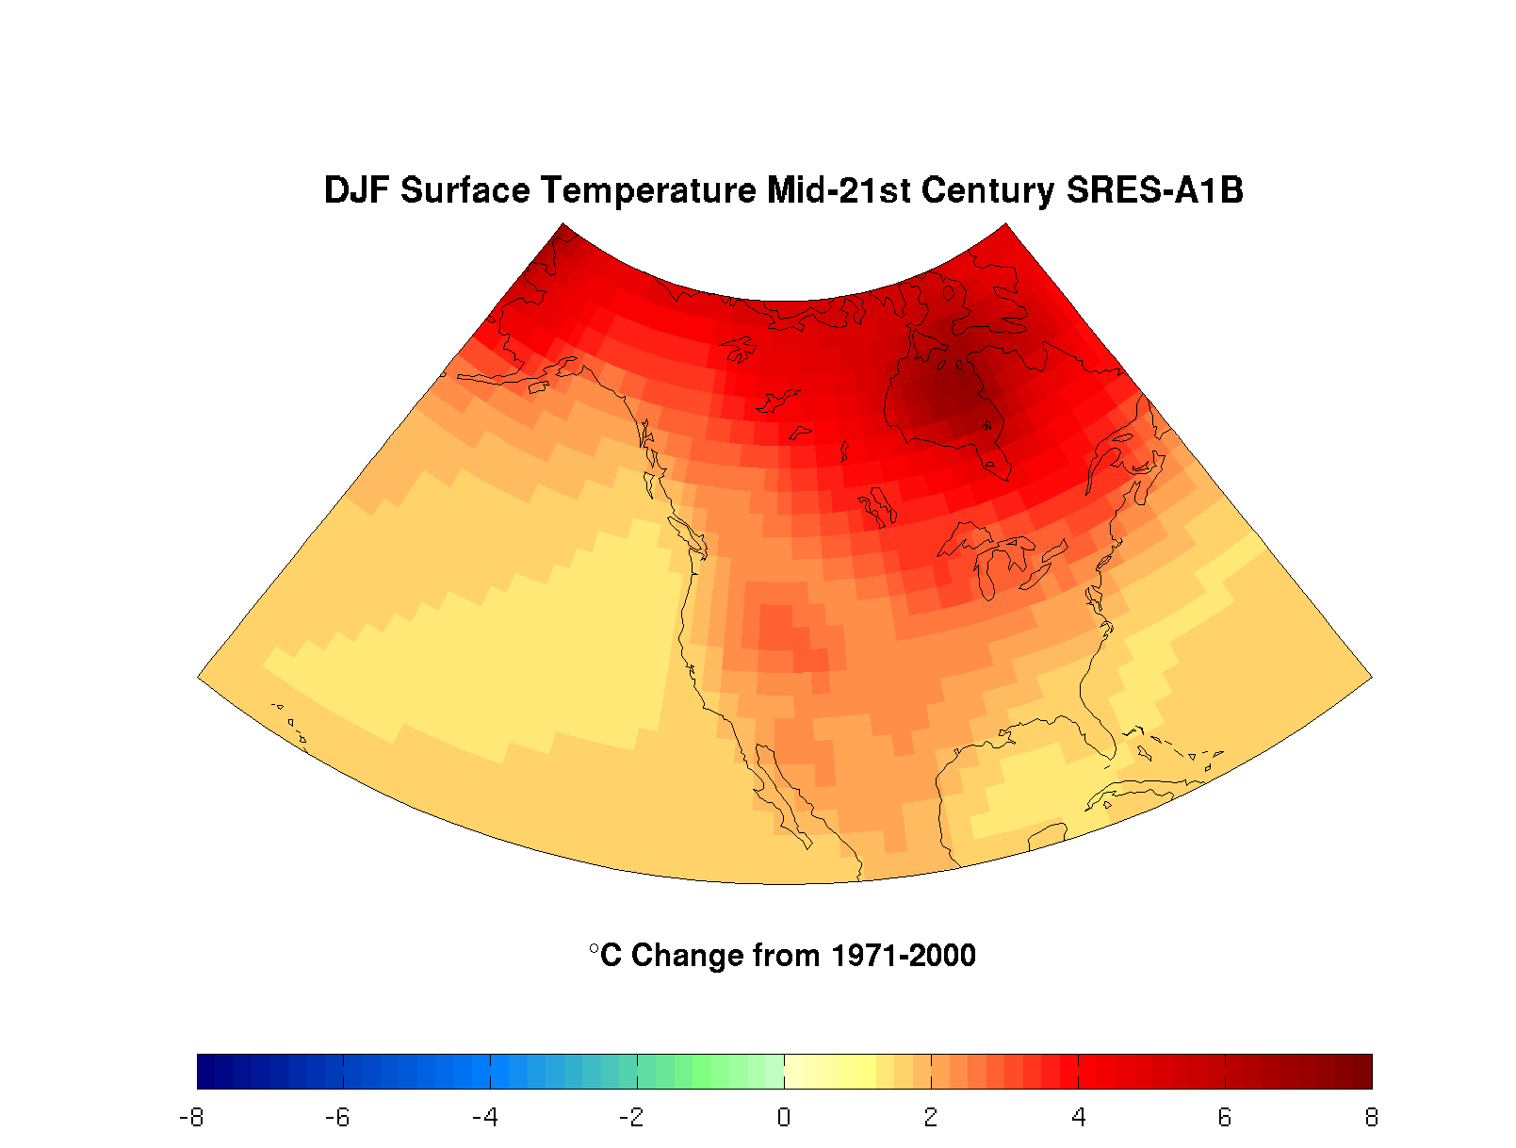
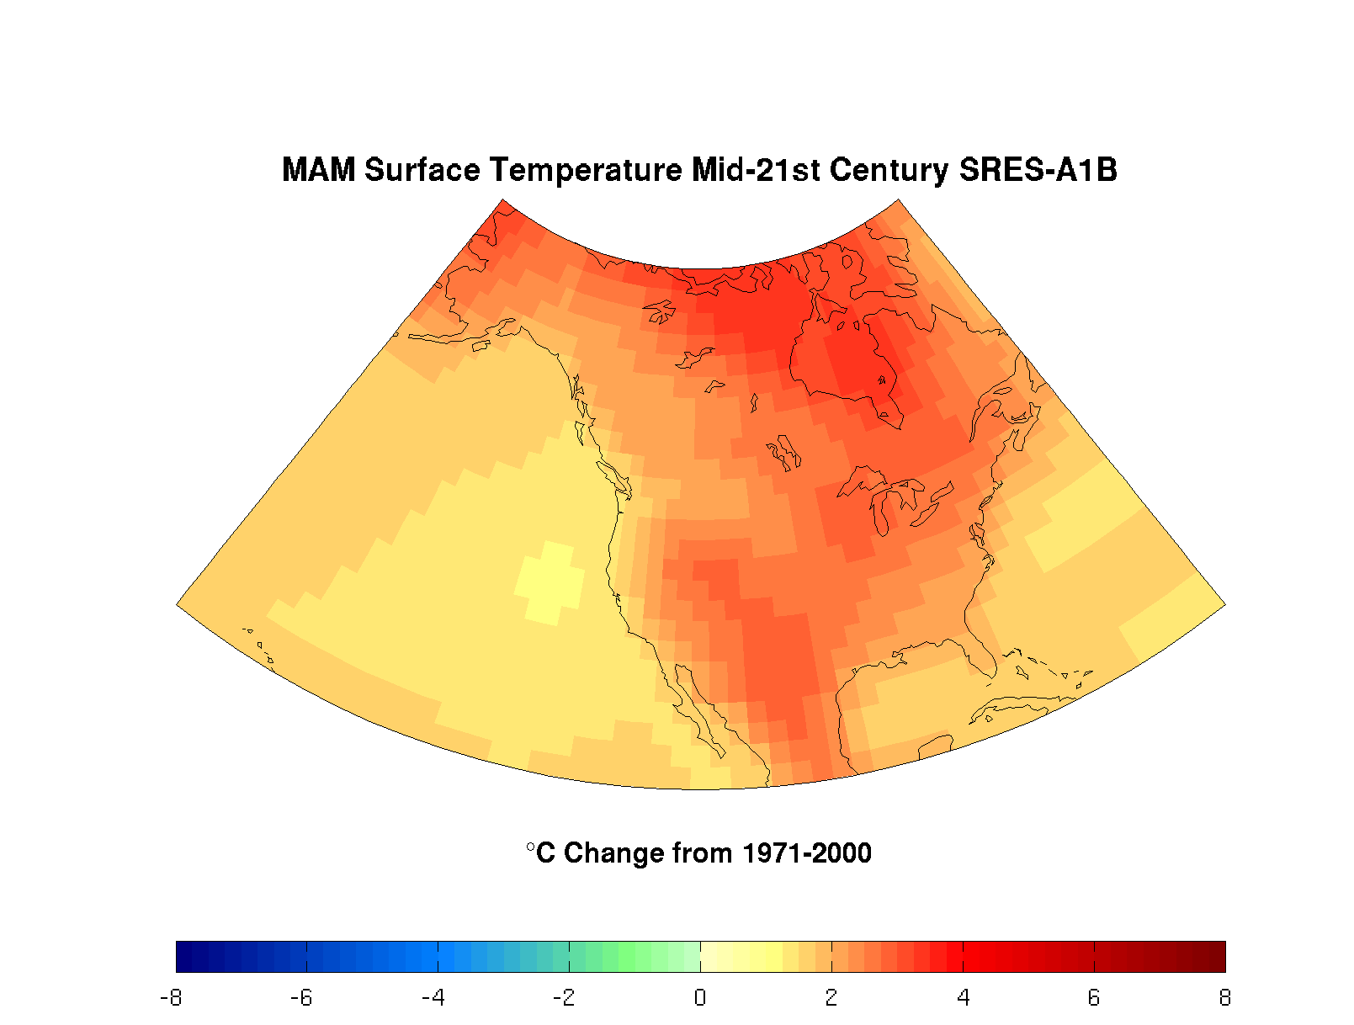
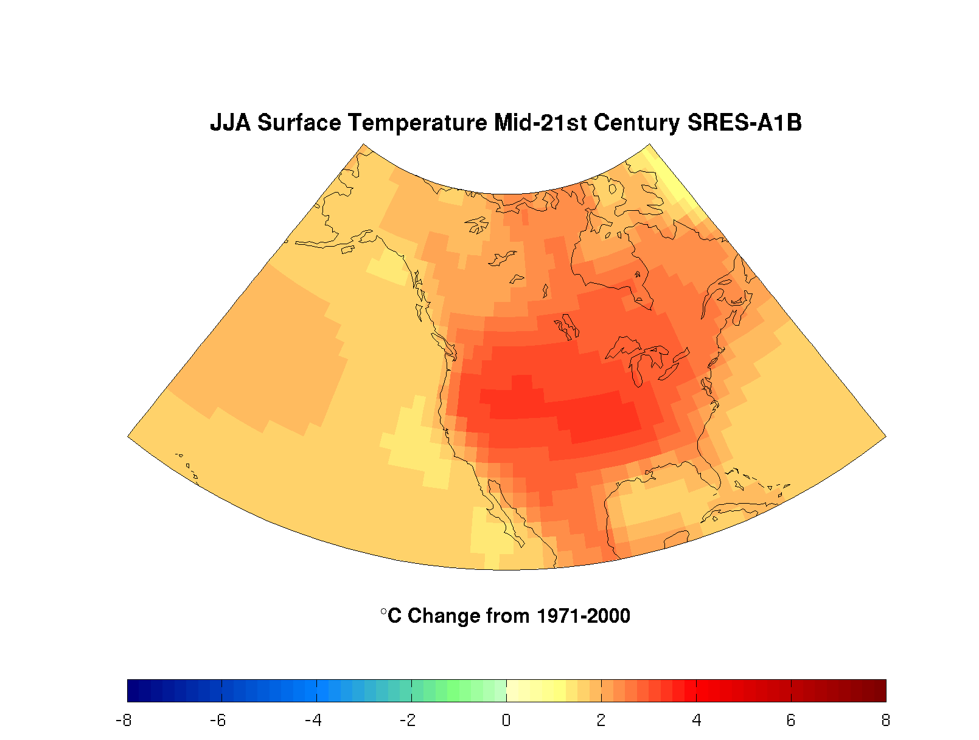
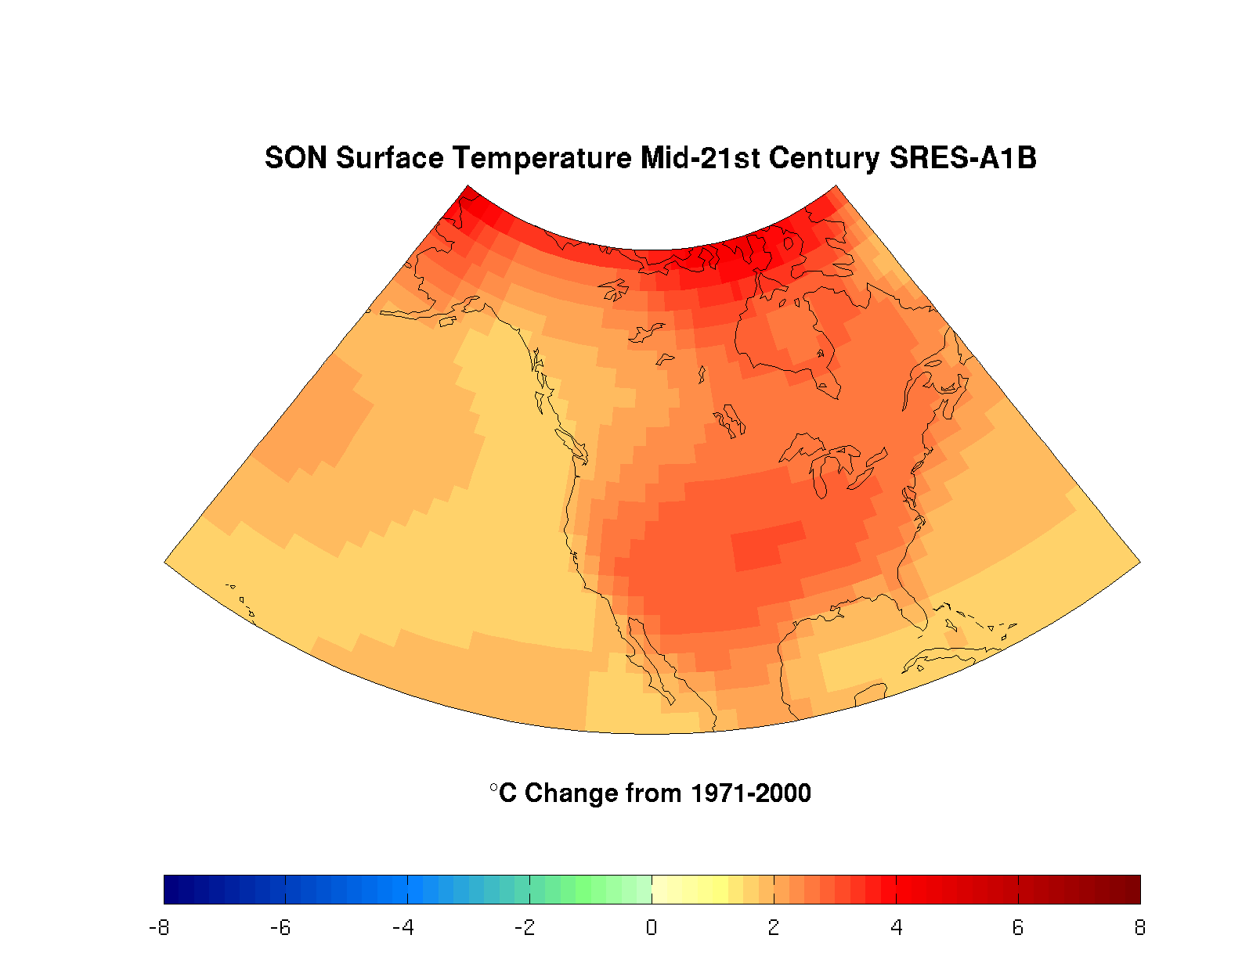
Notes:
Surface temp models using IPCC Scenario Projections
Future difference from 1971-2000 average temp: models using IPCC Scenario Projections

Slide 45
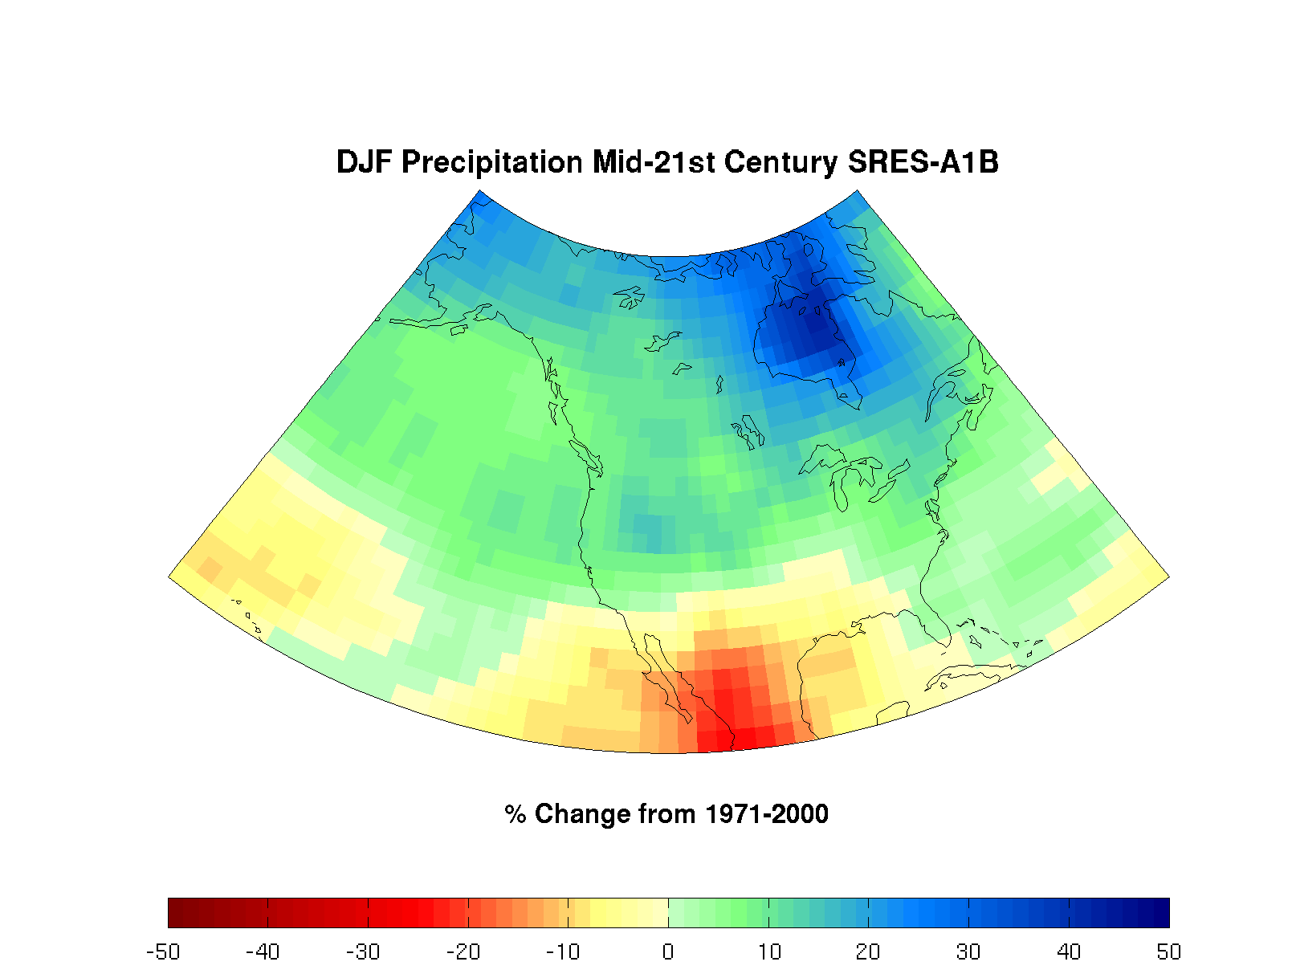
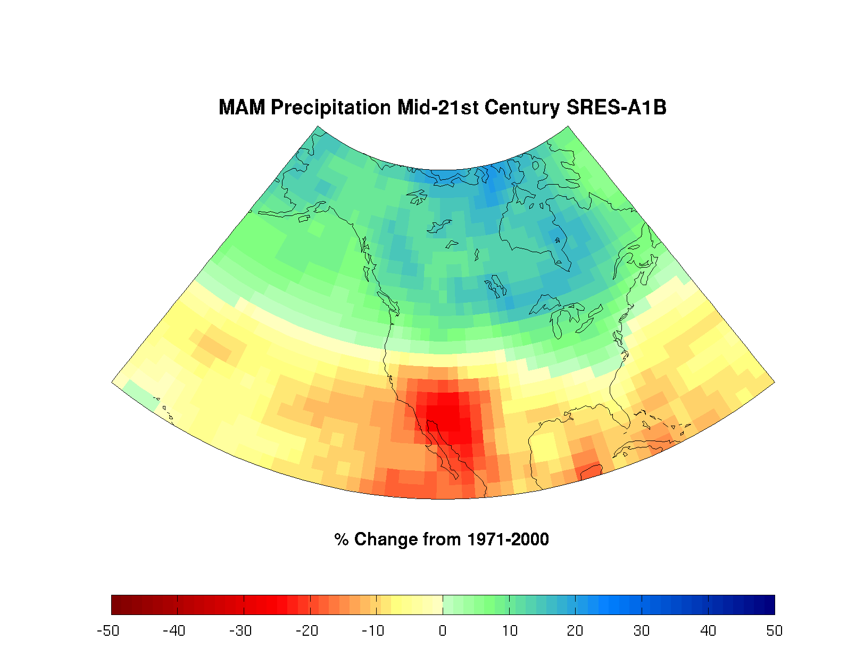
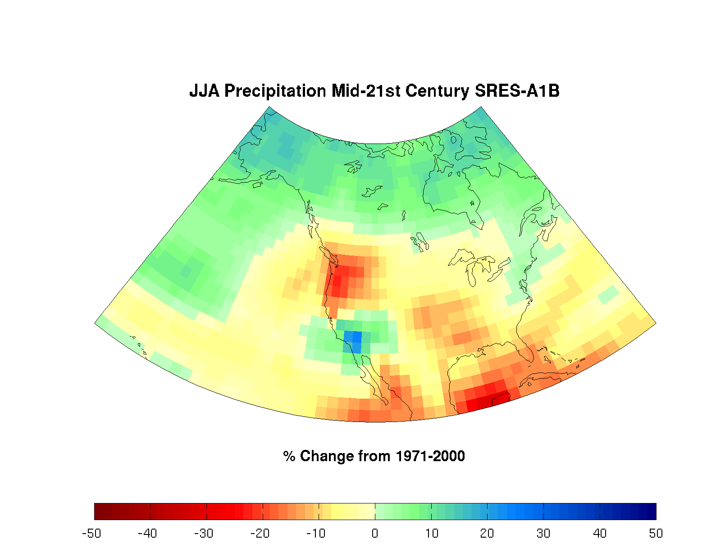
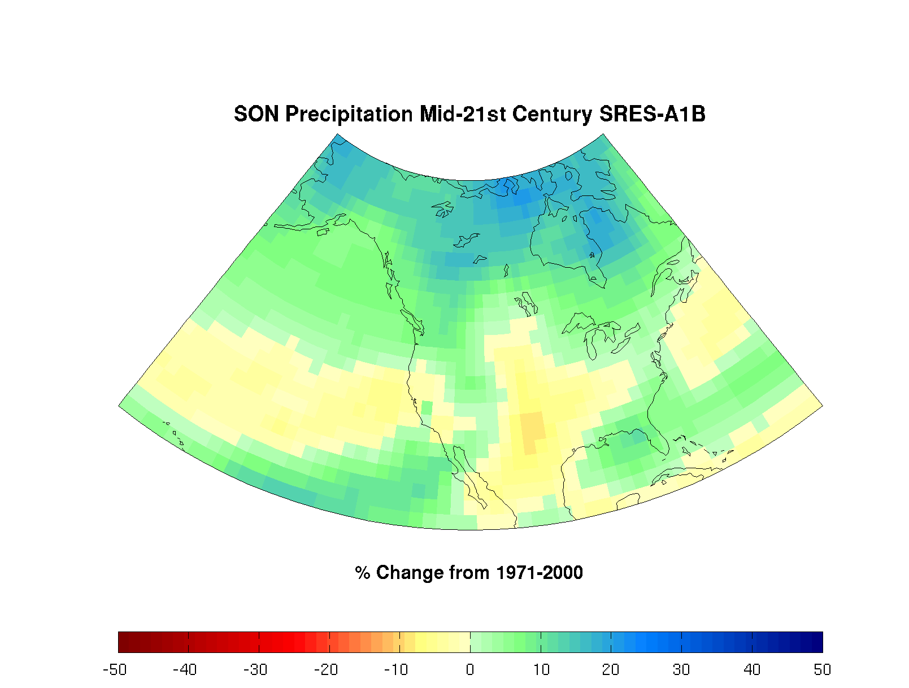
Notes:
Climate anomalies in the NH
Future difference from 1971-2000 average precip: models using IPCC Scenario Projections

Slide 46
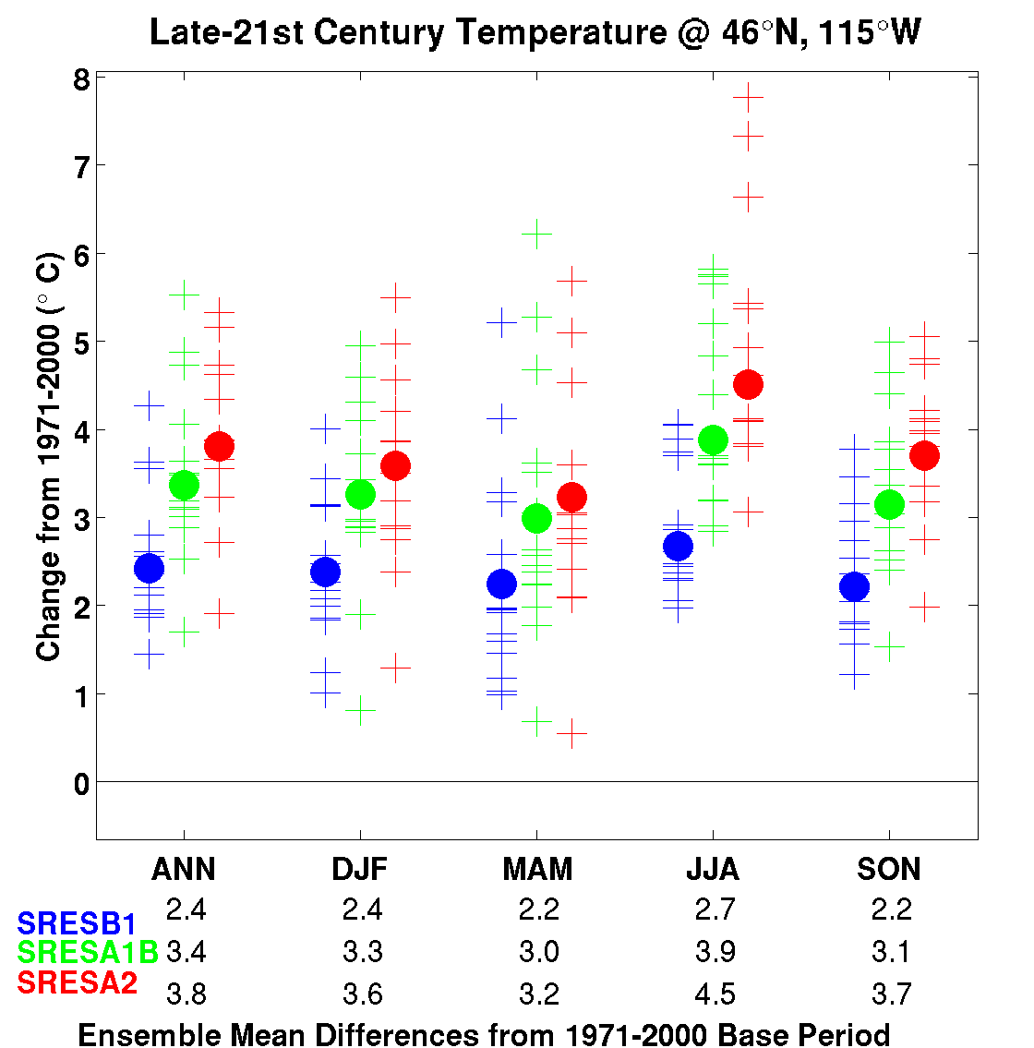
Single
Model
Model
Mean
Colors depict different scenarios
Notes:
Future difference from 1971-2000 average temp: models using IPCC Scenario Projections

Slide 47
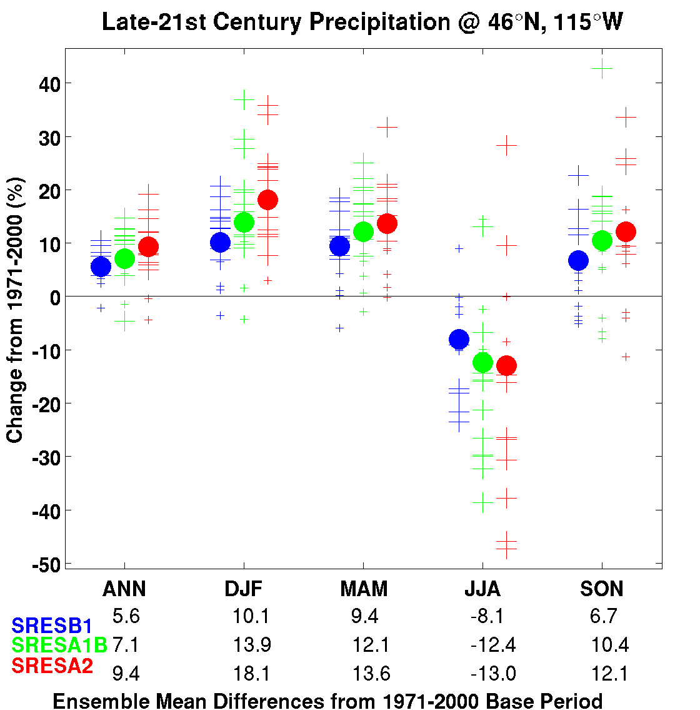
Notes:
Future difference from 1971-2000 average precip: models using IPCC Scenario Projections

Slide 48
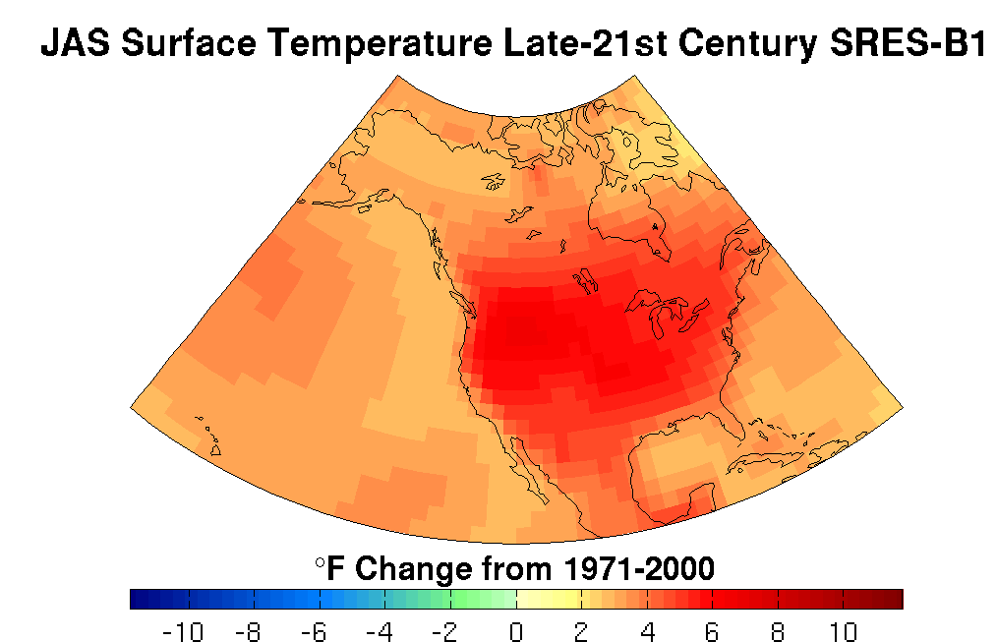
Notes:
Future difference from 1971-2000 average temp: models using IPCC Scenario Projections

Slide 49
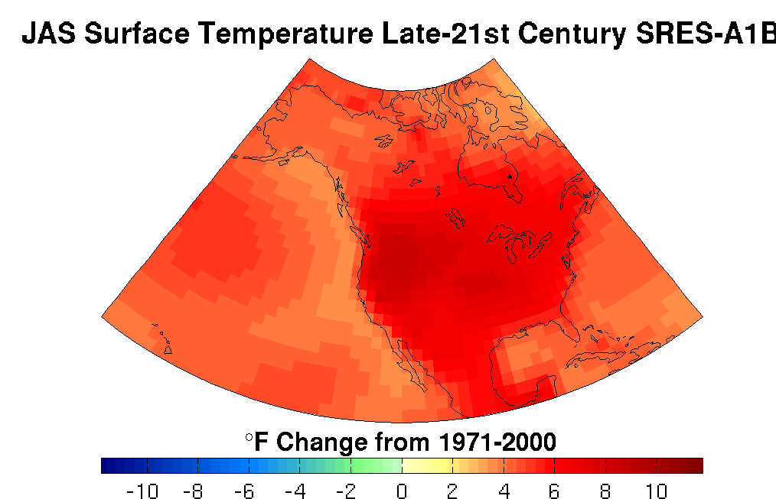
Notes:
Future difference from 1971-2000 average temp: models using IPCC Scenario Projections

Slide 50
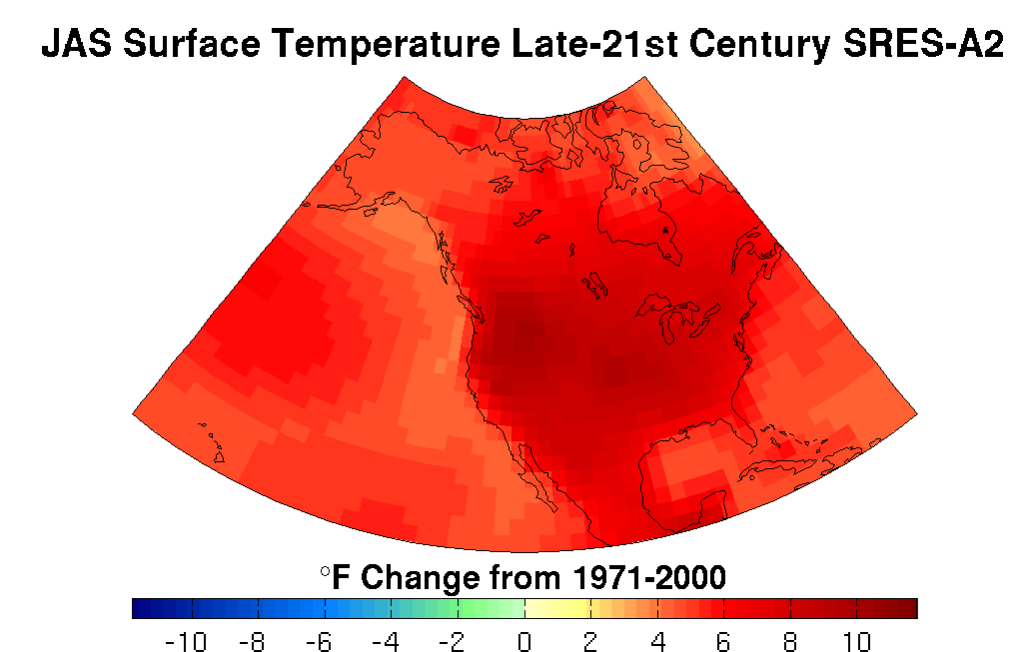
Notes:
Future difference from 1971-2000 average temp: models using IPCC Scenario Projections

Slide 51
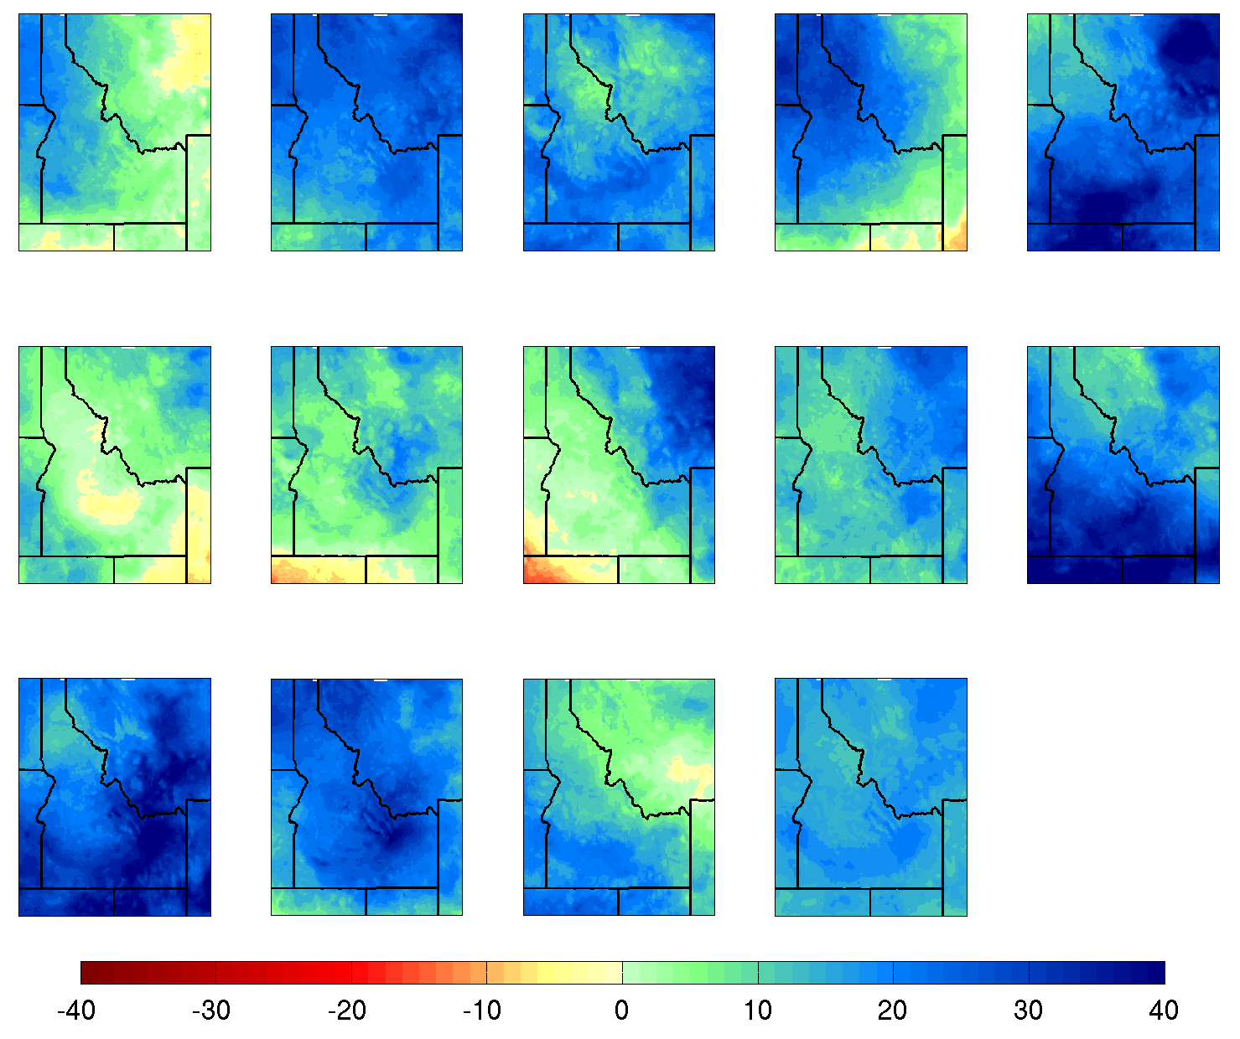
Change in Cool Season (Oct-May) Precipitation
Percent Change Late 21st Century SRES-A1B vs. Late 20th Century 20C3M
MME

Slide 52
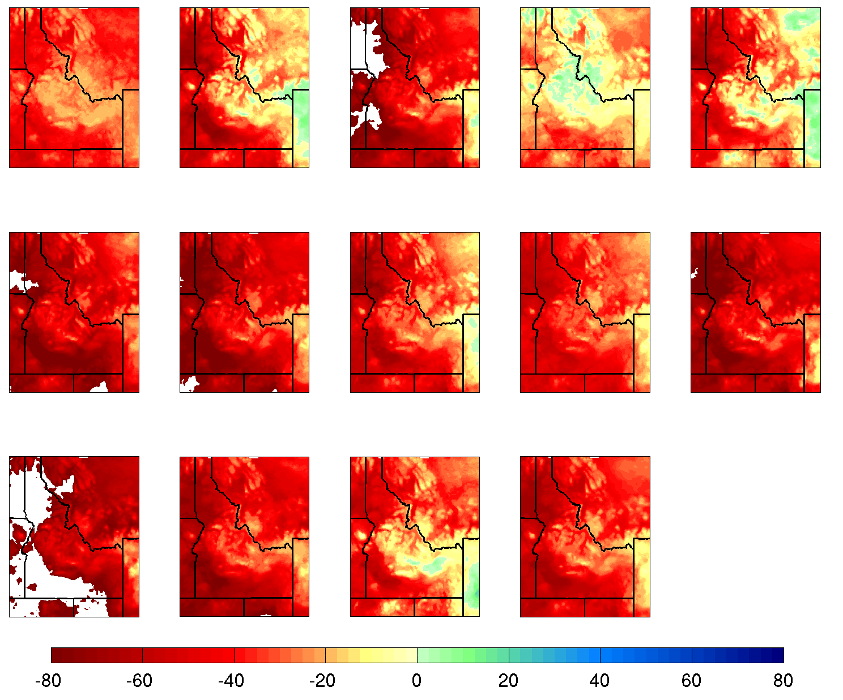
Change in Snowfall (SWE %)
Percent Change Late 21st Century SRES-A1B vs. Late 20th Century 20C3M
MME

Slide 53
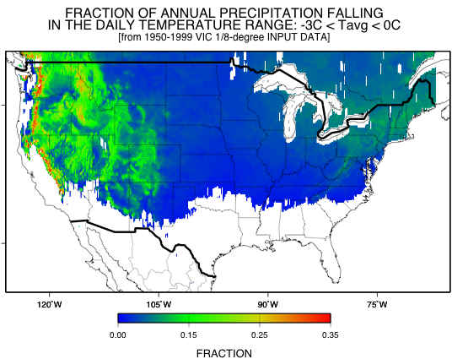
To put these projected levels of of warming into perspective: SENSITIVITY OF HYDROCLIMATE TO A +3ºC WARMING…
Courtesy of Mike Dettinger

Slide 54
What conclusions can you infer from these model experiments?
Models can reasonably predict temperature variations over the last 150 years.
Most of the observed warming detected over the past 50 years is attributable to human activities.
“Most of observed increase in global average temperatures since the mid -20th century is very likely due to observed increase in anthropogenic greenhouse gas concentrations.”
-IPCC AR4 (2007)

Slide 55
Sources
Dr. Crystal Kolden
Dr. John Abatzoglou (http://webpages.uidaho.edu/jabatzoglou/)
More information:
www.westernclimateinitiative.org/
Icenetmatrix.com
http://www.atmos.washington.edu/mm5rt/
http://www.wrcc.dri.edu/research/jtwrcc/idaho-mon/
http://www.wrcc.dri.edu/monitor/WWDT/
http://www.cefa.dri.edu/Westmap/
http://www.cpc.ncep.noaa.gov/products/predictions/90day/

