Slide 1
Climate mitigation and adaptation

Slide 2
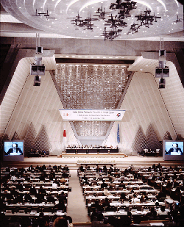
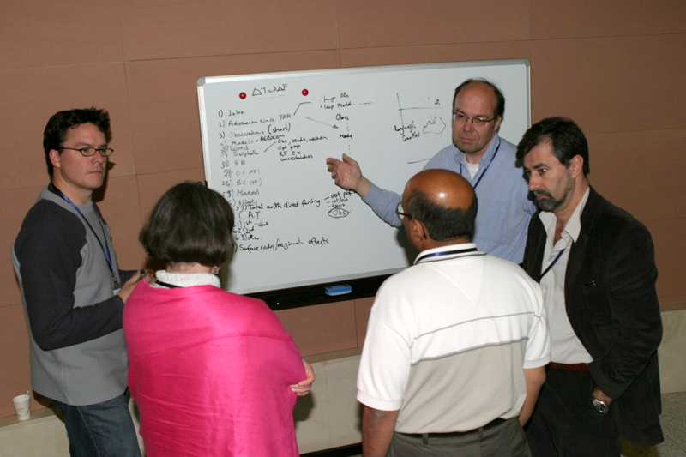
Intergovernmental Panel on Climate Change (IPCC)
Governments require information on climate change for negotiations
Function is to provide comprehensive objective assessments of the science of climate change
Synthesis of science every 6 years (last in 2007, next one 2013/2014)
Scientists review literature on the subject, they don’t conduct research, most volunteer
Group revisions represent a compromise of opinions (3 years, 30000 comments)
Some controversial opinions are slighted (not accepted fully by peers)

Slide 3
More Sustainable Living
Mitigation: reducing greenhouse gas emissions and reducing/avoiding negative environmental impacts
Using less fossil fuels costs less!
We will eventually run out of fossil fuels because they are not a renewable resource.
Adapting to current problems will help us deal with future problems
Storms, droughts, fires are all projected to be more severe in the future.
Plan for future changes
Clean and Green Jobs!
California Clean Air act 1970: $40 returned for every $1 invested
Employs near 130,000 people statewide
Green-collar jobs: energy efficiency, renewables, solutions
Obama: “5 million green-collar jobs” over next 10 years

Slide 4
Controversy
Over 50% of the American public thinks there are disagreements about the cause of current global warming and climate change.
Political Strife
Remember, politicians are not scientists!
Nearly all climate scientists believe that current global warming is anthropogenic
There is disagreement on HOW much of the warming is anthropogenic.

Slide 5
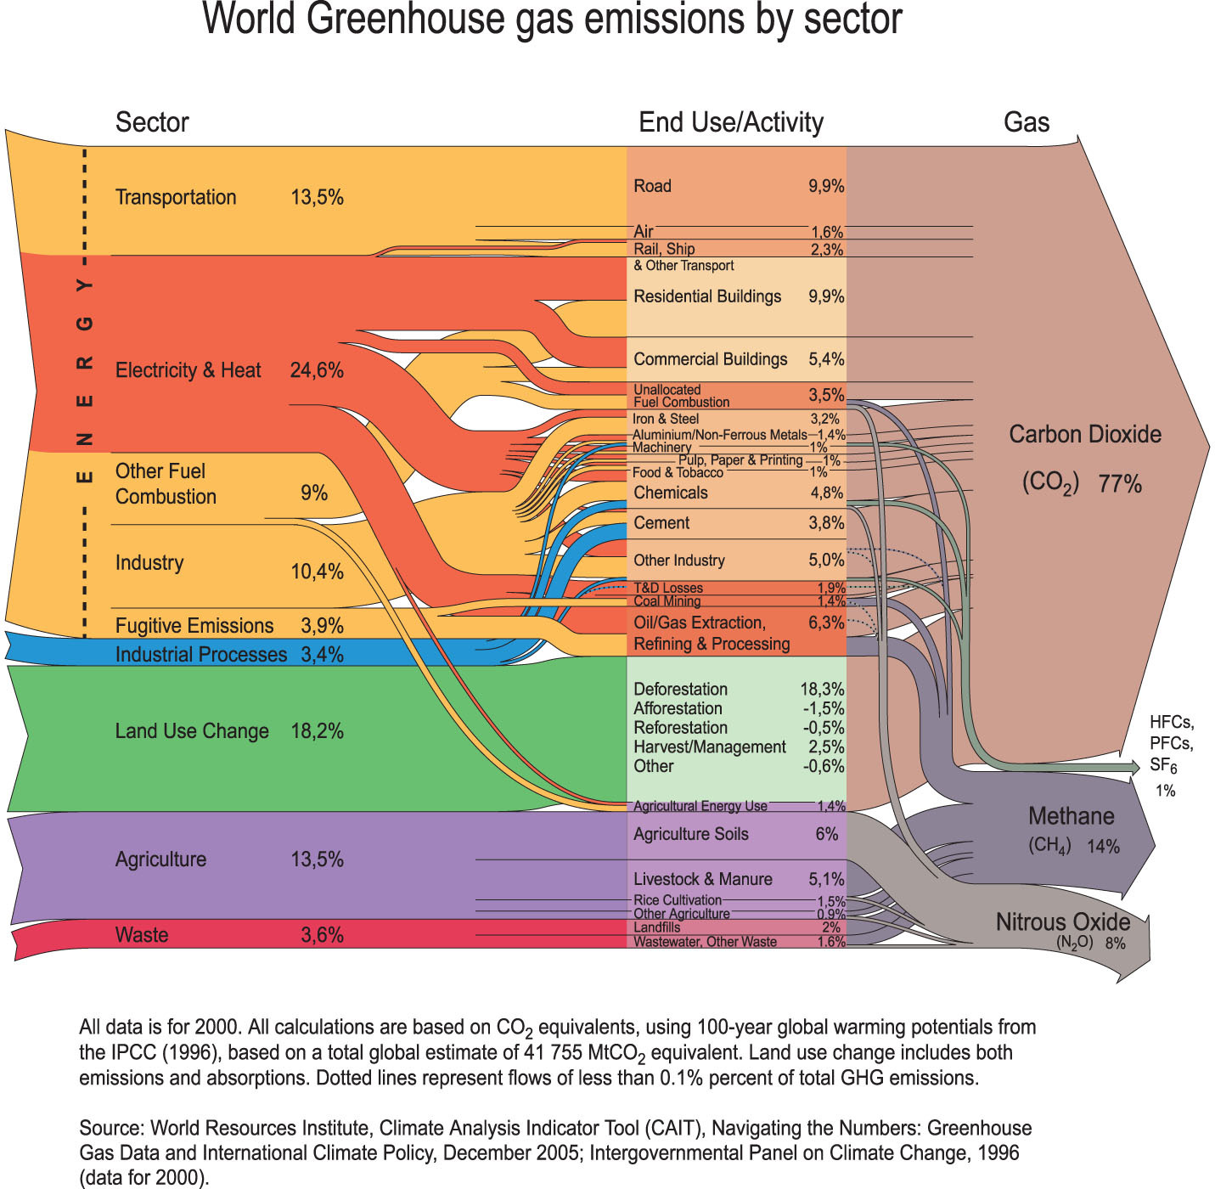
Notes:
Greenhouse gas emissions by sector: 2000

Slide 6
But it will hurt the economy…
California clean air act 1970: 40$ returned for every 1$ invested
Employs near 130,000 people statewide
Green-collar jobs: energy efficiency, renewables, solutions
Obama: “5 million green-collar jobs” over next 10 years
Green-lining on economic fallout
In California (AB 32): carbon dioxide emission reduction bill
Increase state gross product by 4 billion by 2020 (15% increase from just business as usual)
Per capita income increase by $200
100,000 jobs added to economy

Slide 7
3 Step Recovery Program
STEP 1: Admit there is a problem
Accepting that anthropogenic factors have and will contribute to problematic changes in climate that will impact our planet
STEP 2: Action
What can we do?
Adapt to whatever happens: Adaptation
Move towards a drastic reduction of the emissions of greenhouse gases: Mitigation
Do something else to compensate: Geo-engineering
STEP 3: Cooperation
What can one individual do to change the world?

Slide 8
Adaptation
Societies have a long record of adapting to impacts of weather and climate
Idea: Several aspects of climate change are unavoidable, so preparations can be taken to reduce impacts
Proactive planning and management can avert future disasters
Utilize climate change information to prepare 20-50-100 years out

Slide 9
Mitigation
Defined: Steps taken to avoid or minimize negative environmental impacts.
Idea: We can minimize future impacts by limiting the degree or magnitude of the action of emitting greenhouse gases today

Slide 10
Kyoto Protocol
Aimed for
“stabilization of greenhouse gas concentrations in the atmosphere at a level that would prevent dangerous anthropogenic interference with the climate system”
Kyoto Protocol: Reduce CO2 emissions from 1990 levels
A first step toward mitigating climate change

Slide 11
Carbon Dioxide Mitigation
Mitigation: To stabilize carbon dioxide concentrations at a level below the ‘tipping point’
Latest estimate ~ 8000 kg of CO2
To stabilize climate (550ppm)
2200 kg (75% reduction)
Can this be done???
Notes:
Thus, energy use, and the continuing demand for energy are central to the challenges of climate change.

Slide 12
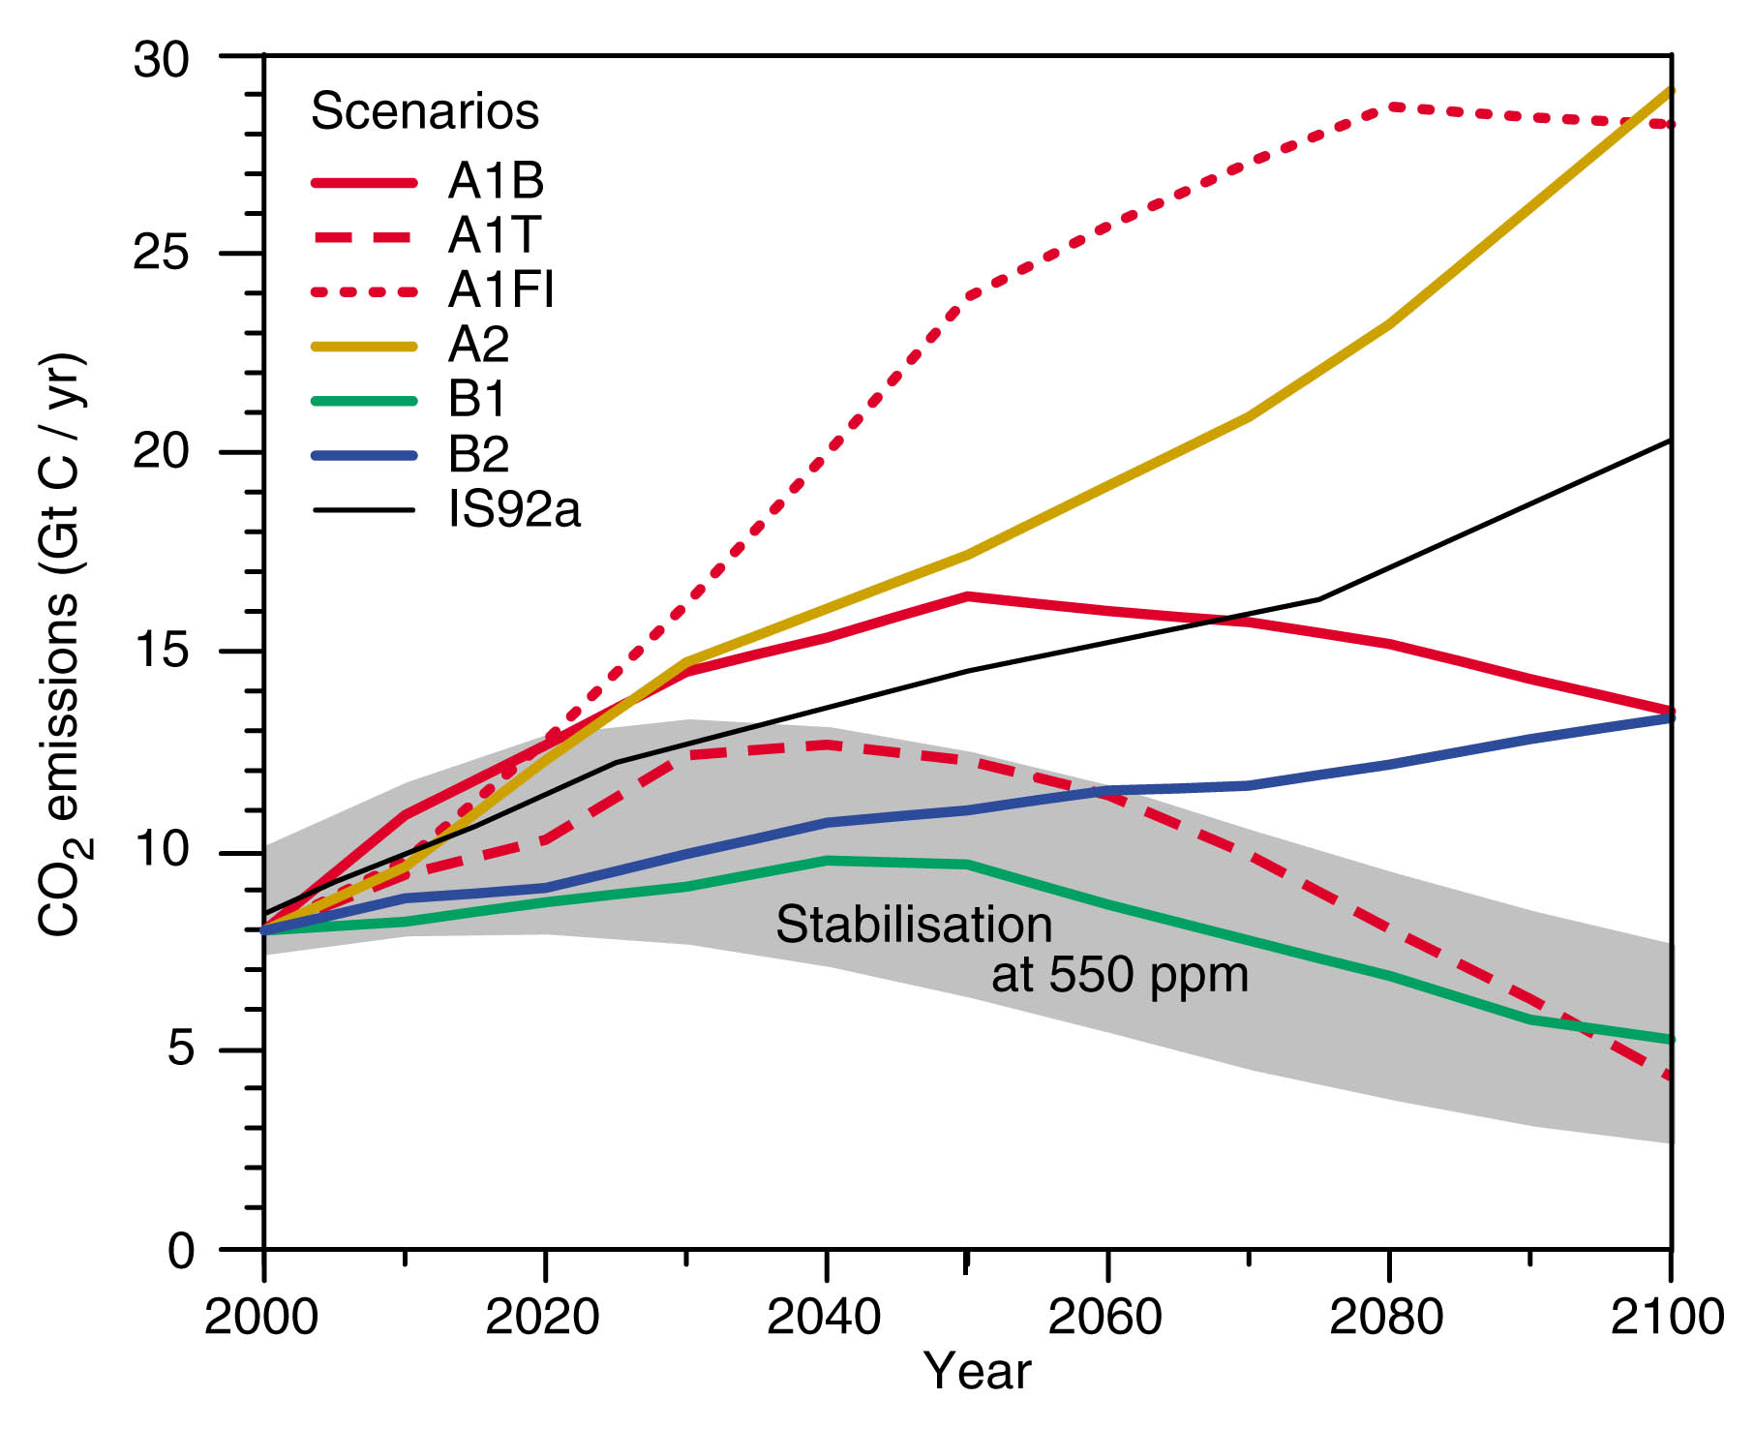
CO₂ emissions for various scenarios (550 ppm)
Kyoto’s goal
Notes:
CO2 emissions for different IPCC scenarios

Slide 13
Hypothetical: GHG vs. Climate Change
Temperature Change by 2100 (C)
1 2 3 4 5
Non-linear influence of GHG
On Climate Change
Why the large change above
550 ppm?
450 550 650 750
CO2 Concentration

Slide 14
Positive vs. Negative Feedbacks
Positive Feedbacks
Ocean solubility
Ice albedo
Water vapor
Wildfires
Methane Hydrates
Ice Sheet Collapse
Negative Feedbacks
Carbon fertilization
Cloud Albedo
Chemical Wxing

Slide 15
Hypothetical: Climate Change vs. Impact
IMPACT
Economic/Environmental Units
Non-linear influence of Climate Change
On Impact
Change <2C is manageable
1 2 3 4 5
Temperature Change (C) by 2100

Slide 16
Hypothetical: GHG vs. Impact
IMPACT
Economic/Environmental Units
Things get expensive
REAL FAST above 550ppm
450 550 650 750
CO2 Concentration

Slide 17
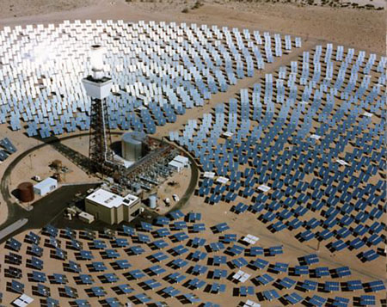
Mojave Desert (2011): 400,000 homes
Notes:
This solar powered 'power tower' is a working example of renewable energy in general use. clearly, the technology used must vary with place. So a power tower probably wouldn't provide too much power in Edinburgh say.

Slide 18
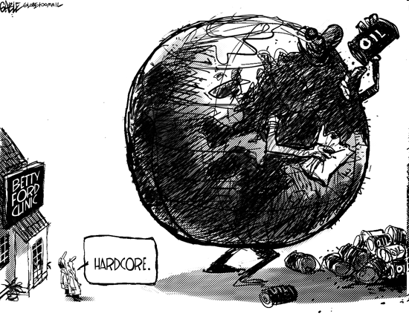
A Carbon Tax???
$10 per ton of CO2 ~ 10 cents per gallon..

Slide 19
Two basic kinds of geo-engineering
Reduce the content of greenhouse gases in the atmosphere
Alter the climate system

Slide 20
Geo-engineering
Reduce the atmospheric greenhouse gas content
SEQUESTERING METHODS
plant trees ~ reforestation
develop & grow special biological organisms
fertilize the oceans

Slide 21
Geo-engineering
2. Alter the climate system
Restore the global energy balance by the management of solar radiation
Recall the simple energy budget from day 1
In terms of the global energy budget a reduction of the solar energy absorbed in the climate system by about 2% might balance a doubling of atmospheric carbon dioxide

Slide 22
1. Space Solar Shields
Install a network of orbiting reflective shields to enhance global albedo
Fast: cooling could occur within a decade time
Cost : hundreds of millions of dollars -- cheap compared to other options
Side effects: vegetation responds to solar radiation, cloud formation, precipitation decrease (dimming analog)

Slide 23
2. Mimic Volcanoes in Stratosphere
Volcanoes cool climate temporarily ~ 12-18 months
Proposed Idea: inject sulfur dioxide into the stratosphere
Would need equivalent of an El-Chichon or Pinatubo every year to counter warming
Cost: 100-200 billion dollars per year
Pro: Abrupt end to warming
Con: same as prior plus contributes to ozone loss in stratosphere, expensive

Slide 24
3. Cloud seeding : low clouds
Reroute shipping routes where more CCN will form longer lived low-clouds
Cloud seeding ships inject aerosols (sea salt) and moisture to atmosphere
This works similar to the indirect effect of aerosols to enhance stratus formation
Cost: 5 billion for ships…
Pro: Controllable, energy neutral (alternative energy)

Slide 25
4.Increase the reflectivity (albedo) of the surface
Paint the deserts white
Enhance reflectivity of human settlements
Develop & use more reflective grasses

Slide 26
Thoughts on Geo-engineering
Our understanding of likely climate change due to geo-engineering “solutions” is far less than that of enhanced carbon dioxide concentrations
Are these solutions, or more experiments? And what are the unintended impacts?
Legal and political ramifications
Who will pay for this?
Who will control the switch?
Is it a good way of buying time until serious greenhouse gas emission reductions have been agreed and executed?

Slide 27
The WHAT IF game…
It is very likely that climate will continue (accelerate) changing over the 21st century…
It is *possible* that other external forcing mechanisms may cancel out these change…
What if climate doesn’t change?
What if climate does change?

Slide 28
Four Scenarios for a Future World
ADAPTATION/MITIGATION
We acted
We didn’t act
Cost of mitigation is significant
Wasted $$$
No Cost, No Harm
Life is good, phew!!!
It didn’t happen
FUTURE CLIMATE CHANGE
Cost of mitigation is significant
Averted extreme disaster
Money very well spent
No Cost
Global Devastation
It happened
Notes:
http://www.youtube.com/watch?v=zORv8wwiadQ

Slide 29
Sources
Dr. Crystal Kolden
Dr. John Abatzoglou (http://webpages.uidaho.edu/jabatzoglou/)
More information:
www.westernclimateinitiative.org/
Icenetmatrix.com
http://www.atmos.washington.edu/mm5rt/
http://www.wrcc.dri.edu/research/jtwrcc/idaho-mon/
http://www.wrcc.dri.edu/monitor/WWDT/
http://www.cefa.dri.edu/Westmap/
http://www.cpc.ncep.noaa.gov/products/predictions/90day/

